Slide 1
LIGHT CSW 2023 Quantitative Analysis Workshop
Session 1: R tutorial Alexandra Richards, Marc Henrion

Slide 2
Introduction

Slide 3
Preliminaries
Course website / GitHub: https://github.com/mlw-stats/LIGHT_CSW2
Housekeeping
Refreshments & lunch
Fire exits & bathrooms

Slide 4
Learning outcomes
KNOW R: Explain know what R is & what it can do.
KNOW R RESOURCES: List useful R resources and access them.
DO R: Perform basic operations relevant for your research in R:
Read data into R & write data or results to the harddrive.
Manipulate & use different object types.
Write & use functions in R
Perform basic analyses on a dataset: mean, standard deviation, linear regression.
Produce various standard graphs and tables
UNDERSTAND STUDY DESIGNS: Recommend appropriate designs & analyses.
COMPREHEND OPEN SCIENCE: Summarise principles of open, reproducible research.
DO OPEN SCIENCE WITH R: Use R scripts, R markdown / quarto, & GitHub.

Slide 5
What you will not achieve in this workshop
You will not be proficient in R by the end of the week.
You will not be proficient in statistics. We cover only some of the basics .
Workshop materials are meant as a resource / reference.
It is up to you to then develop yourself further after the workshop.

Slide 6
What is R?
2 ways of writing R code:
Classic / base R
RStudio / tidyverse
Syntax can be quite different:
tidyverse relies on a number of linked packages.
tidyverse aims for simplicity: less coding, more thinking.
Whichever is most intuitive to you, will be best for you!
Engine the same
We will focus primarily on tidyverse in this workshop.

Slide 7
Getting started
R and RStudio IDE

Slide 8
Getting started - R and RStudio IDE
There are 2 main parts of software that you will need.
R is an environment for statistical computing. It is a programming language, specifically a scripting / interpreted language that does not require compilation.
https://cran.r-project.org/
RStudio is a company who have developed the most used graphical user interface (GUI) / integrated development environment (IDE) for R.
https://www.rstudio.com

Slide 9
Getting started - R and RStudio IDE
R is free and open source. Most latest statistical developments are first implemented in R. Unlike commercial packages (SAS, Stata, …), there is little to no quality control for R packages other than feedback from users. Be aware of this!
You will mostly interact with R through RStudio, so familiarise yourself with its interface.

Slide 10
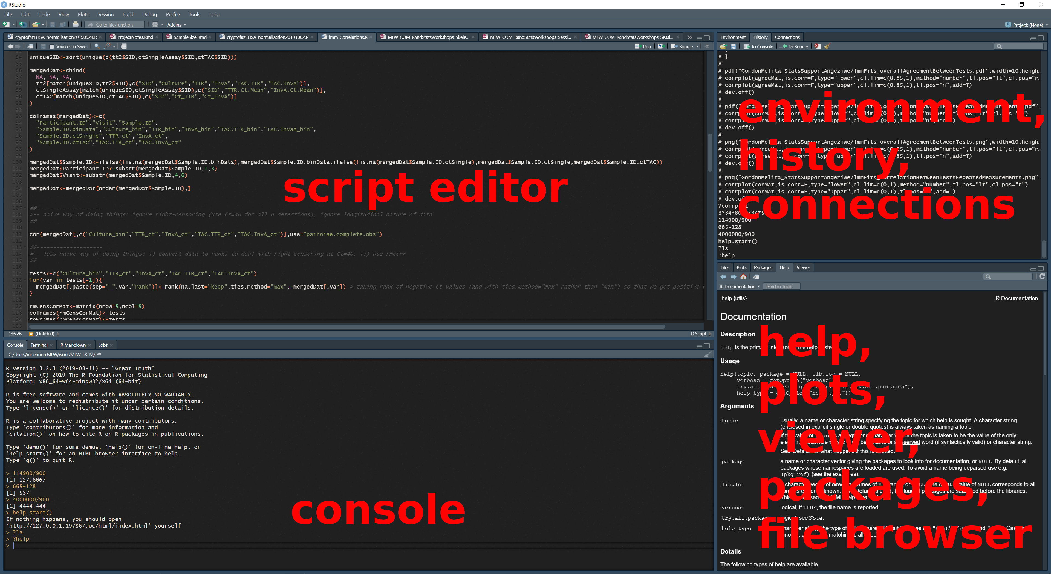
Getting started - R and RStudio IDE
RStudio interace

Slide 11
Getting started
Resources

Slide 12
Getting started - Resources
R help files
Type ? followed by the name of the command you want to get help on.
Type help.start() to open manuals, FAQs and other material.
CRAN
Tutorials & manuals: https://cran.r-project.org/manuals.html
Task views: https://cran.r-project.org/web/views/
RStudio
Cheatsheets: https://rstudio.com/resources/cheatsheets/
Text books
Many, but this one is excellent and free: http://r4ds.had.co.nz
Online tutorials, blogs, forums
Why R? webinars http://whyr.pl/foundation/webinars/
R-bloggers https://www.r-bloggers.com/
Stack overflow https://stackoverflow.com/questions/tagged/r
R Graph Gallery https://www.r-graph-gallery.com/

Slide 13
Getting started
R packages

Slide 14
Getting started - R packages
R is stand-alone and you can code any functions you need for your analysis.
Easier to use R packages: pre-coded sets of R functions and data.
In fact, a standard installation of R comes with 15 core and 15 recommended packages:
Base: base, compiler, datasets, graphics, grDevices, grid, methods, parallel, splines, stats, stats4, tcltk, tools, translations, utils
Recommended: KernSmooth, MASS, Matrix, boot, class, cluster, codetools, foreign, lattice, mgcv, nlme, nnet, rpart, spatial, survival
Packages are hosted either on the Comprehensive R Archive Network (CRAN, https://cran.r-project.org) or on Bioconductor (https://bioconductor.org). CRAN is the most commonly used of these with Bioconductor packages mostly targeted at bioinformaticians.

Slide 15
Getting started - R packages
You install packages from CRAN by using the install.packages() function.
For example:
install.packages("tidyverse") install.packages("lubridate")
And you load packages by using the function library(), for example:
library(tidyverse) library(lubridate) library(gridExtra)

Slide 16
Getting started - R packages
Installation details for Bioconductor packages are given on the Bioconductor website for each package.
See e.g.: https://bioconductor.org/packages/release/bioc/html/variancePartition.html.

Slide 17
Reading and writing data

Slide 18
Reading and writing data
As the most basic task for any analysis in R, you need to be able to read your data into R and, at the end, write the results to a file on your har drive.
Let’s start by using some data that R comes with, write it out to the disk, then read it back in.
The dataset iris is a famous dataset recording 150 observations of 3 species of flowers. It was extensively used by Ronald Fisher as he developed his statistical theory. Find out more about the data by typing ?iris at the R console.

Slide 19
Reading and writing data
Writing data to disk

Slide 20
Reading and writing data - Writing data
We will use iris which is a data frame of 150 rows and 5 columns (variables Sepal.Length, Sepal.Width, Petal.Width, Species). If you want to see another way of storing the same data, have a look at iris3 - a 3-dimensional array.
head(iris) ## Sepal.Length Sepal.Width Petal.Length Petal.Width Species ## 1 5.1 3.5 1.4 0.2 setosa ## 2 4.9 3.0 1.4 0.2 setosa ## 3 4.7 3.2 1.3 0.2 setosa ## 4 4.6 3.1 1.5 0.2 setosa ## 5 5.0 3.6 1.4 0.2 setosa ## 6 5.4 3.9 1.7 0.4 setosa

Slide 21
Reading and writing data - Writing data
dim(iris) ## [1] 150 5 table(iris$Species) ## ## setosa versicolor virginica ## 50 50 50

Slide 22
Reading and writing data - Writing data
Now, let’s write this as a comma-separated file:
dir.create("dataAndSupportDocs",showWarnings=FALSE) # creates a directory write.csv(iris,file="dataAndSupportDocs/iris.csv",row.names=FALSE) # saves the data to a csv file
Check on your hard drive, you will now have a file named iris.csv (inside a directory named dataAndSupportDocs) which you can open with a text editor, Excel, …

Slide 23
Reading and writing data
Reading data from disk

Slide 24
Reading and writing data - Reading data
Let’s suppose now that this file is our dataset and we want to load it into R so that we can work with it.
We need to read the content into memory (RAM) and assign it to an object in R that we can then manipulate or feed into different functions for analysis or visualisation.
For this we use the function read.csv() and the assignment operator <-.

Slide 25
Reading and writing data - Reading data
dat<-read.csv("dataAndSupportDocs/iris.csv") head(dat) ## Sepal.Length Sepal.Width Petal.Length Petal.Width Species ## 1 5.1 3.5 1.4 0.2 setosa ## 2 4.9 3.0 1.4 0.2 setosa ## 3 4.7 3.2 1.3 0.2 setosa ## 4 4.6 3.1 1.5 0.2 setosa ## 5 5.0 3.6 1.4 0.2 setosa ## 6 5.4 3.9 1.7 0.4 setosa

Slide 26
Reading and writing data - Reading data
dim(dat) ## [1] 150 5 table(dat$Species) ## ## setosa versicolor virginica ## 50 50 50

Slide 27
Reading and writing data - Reading data
There are alternatives: e.g. the more general function read.table().
dat2<-read.table(sep=",",header=T,file="dataAndSupportDocs/iris.csv") dim(dat2) ## [1] 150 5 table(dat2$Species) ## ## setosa versicolor virginica ## 50 50 50

Slide 28
Reading and writing data
Binary files

Slide 29
Reading and writing data - binary files
You can also save to a binary, R format file.
This takes up less space on the hard drive and loads faster.
save(iris,file="dataAndSupportDocs/iris.RData") # preserves variable name saveRDS(iris,file="dataAndSupportDocs/iris.rds") # does not preserve variable name

Slide 30
Reading and writing data - binary files
load() for saved workspaces and objects saved using save(). Object names in R will be the same as when they were saved, no object assignment:
load("dataAndSupportDocs/iris.RData")
readRDS() for objects saved using saveRDS(). Need to assign to an object:
obj<-readRDS("dataAndSupportDocs/iris.rds")

Slide 31
Reading and writing data
Other formats

Slide 32
Reading and writing data - Other formats
library(foreign)
Stata (up to Stata 12 dta format)
SPSS
Epi Info
Minitab
Octave / Matlab
…
Stata dta format versions can be painful
library(readstata13)

Slide 33
Reading and writing data - Other formats
Excel and other spreadsheets
Tricky: several sheets, formulae, macros, …
Best: export as text file
Otherwise:
library(xlsx) library(XLConnect) library(readxl) # the most commonly used of these
Can also write Excel formats:
library(xlsx) library(dataframes2xls) # xls only library(WriteXLS) # xls only

Slide 34
Working with data

Slide 35
Working with data
Data & object types

Slide 36
Working with data - Data & object types
A variable has one of 4 levels of measurement:
nominal - classifies observations into different categories
alive / dead
human, fish, goat, bird
ordinal - different categories, but categories are ordered
low, medium, high
interval - ordered data with degree of difference; ratios not meaningful
temperature in centigrade: difference betwen 10º and 20º same as between 50º and 60º but 20º not twice as hot as 10º
ratio - interval data with a unique, non arbitrary zero value; ratios meaningful
temperature in Kelvin
length

Slide 37
Working with data - Data & object types
R supports the following data types:
Character
a<-c("male","female")
Integer
b<-1:4
Numeric / double
c<-8/11 d<-pi

Slide 38
Working with data - Data & object types
Logical / boolean
e<-1:10 %% 2 == 0 f<-TRUE g<-4<2
Factor / nominal
h<-factor(sample(a,size=20,replace=T))

Slide 39
Working with data - Data & object types
Dates & date-times
Dates are a special type of data and require special functions to work with. By far the most helpful package is lubridate. It allows you to easily parse date format, using functions like ymd(), ymd_hms(), ym()…
See the lubridate cheat sheet for more information.
ymd("2022-06-04") ## [1] "2022-06-04" ymd("2022 June 4") ## [1] "2022-06-04"

Slide 40
Working with data - Data & object types
Dates & date-times
ymd_hms("2022-06-04 10:00:00") ## [1] "2022-06-04 10:00:00 UTC" ym("2022-06") ## [1] "2022-06-01" ymd("2022-06-04") - ymd("2021-03-02") ## Time difference of 459 days

Slide 41
Working with data - Data & object types
Object types
Vectors
A single number or word is just a vector of length 1.
You can create vectors with the function c().
E.g. v1<-c(1,2,-12.34,5/6)
Shorthands for certain types of vectors, e.g. v2<-1:10
You can access individual elements of a vector, e.g. 3rd element v1[3]
Matrices
Matrices hold data tables (rows and columns).
All elements of a matrix need to be of the same type (e.g. all numeric or all character).
You can create matrices with the function matrix().
E.g. m1<-matrix(nrow=2,byrow=TRUE,1:16)
You can access individual elements of a matrix, e.g. 2nd row, 3rd column m1[2,3]

Slide 42
Working with data - Data & object types
Object types (cont’d)
Arrays
Generalise matrices to have any number of dimensions (i.e. more than just 2, e.g. 3x3x2).
Not used that commonly.
E.g. a1<-table(mtcars$cyl,mtcars$gear,mtcars$am)
You can access individual elements of an array, e.g. a1[3,1,2]
Lists
Lists are very flexible objects that can hold several elements.
Each element can be of a different type.
Elements can (but don’t need to) be named.
E.g. l1<-list(wordVector=c("hello","how","are","you","?"),numberMatrix=matrix(nrow=3,1:9))
You can access individual elements, e.g. first element l1[[1]] or by name l1$wordVector

Slide 43
Working with data - Data & object types
Object types (cont’d)
Data frames
This is the most common object you will use to work with data, e.g. read.table() returns a data frame.
Data frames are like matrices in that they provide a data table (rows and columns) but unlike matrices allow different data types for different columns.
Technically data frames are special types of lists. This means that you can access individual columns / variables by using the $ notation.
E.g. df1<-data.frame(pid=1:5,name=c("Chimwemwe","Esther","John","Dalitso","Julie")) or object dat from earlier.
You can access individual variables, e.g. df1$name or df1[,"name"] or df[,2].
You can access individual rows, e.g. df1[1,].
You can access individual elements, e.g. df1[3,2] or df$name[3]

Slide 44
Working with data - Data & object types
Object types (cont’d)
Tibbles
Tibbles are data frames, but have special methods for printing, accessing and working with them.
Tibbles are used by the tidyverse packages.
E.g. read_csv() returns a tibble.
Use tibbles just like data frames.
The rules of tidy data:
1 row = 1 observation
1 column = 1 variable
1 cell = 1 value.

Slide 45
Working with data
Handling data

Slide 46
Working with data - handling data
Often you only want to work with a subset of your data. This may be that you are interested only in one group of observations or that you may want to get rid of irrelevant variables. The dplyr package provides 2 easy to use function for this: filter and select.
filter() allows filtering out only certain observations
select() allows selecting specific variables
For example:
filter(.data=iris,Species=="setosa") # only 'setosa' observations select(.data=iris,Petal.Width,Petal.Length) # only the Petal.Width and Petal.Length variables

Slide 47
Working with data - handling data
Often you want to combine these operations. For this, pipes are useful.
The tidyverse package magrittr introduced a pipe operator, %>%, to R. You may be familiar with pipes if you have done any shell scripting before (e.g. bash or zsh where the pipe operator is |). Pipes allow to transfer the output of one function as input to another function. This allows for more concise code.
Since R v4.1.0 there is also a native pipe symbol in R: |>.

Slide 48
Working with data - handling data
For example:
iris %>% filter(Species=="setosa") %>% select(Petal.Width,Petal.Length) %>% head(n=5) ## Petal.Width Petal.Length ## 1 0.2 1.4 ## 2 0.2 1.4 ## 3 0.2 1.3 ## 4 0.2 1.5 ## 5 0.2 1.4

Slide 49
Working with data - handling data
iris |> filter(Species=="setosa") |> select(Petal.Width,Petal.Length) |> head(n=5) ## Petal.Width Petal.Length ## 1 0.2 1.4 ## 2 0.2 1.4 ## 3 0.2 1.3 ## 4 0.2 1.5 ## 5 0.2 1.4

Slide 50
Working with data - handling data
To create new variables from existing ones, you can use the function mutate() (add new variables and preserve existing ones) and transmute() (add new variables but drop existing ones) from the dplyr package (part of the tidyverse).
irisNew <- iris %>% mutate( LRatio=Sepal.Length/Petal.Length, WRatio=Sepal.Width/Petal.Width )

Slide 51
Working with data - handling data
head(irisNew) ## Sepal.Length Sepal.Width Petal.Length Petal.Width Species LRatio WRatio ## 1 5.1 3.5 1.4 0.2 setosa 3.642857 17.50 ## 2 4.9 3.0 1.4 0.2 setosa 3.500000 15.00 ## 3 4.7 3.2 1.3 0.2 setosa 3.615385 16.00 ## 4 4.6 3.1 1.5 0.2 setosa 3.066667 15.50 ## 5 5.0 3.6 1.4 0.2 setosa 3.571429 18.00 ## 6 5.4 3.9 1.7 0.4 setosa 3.176471 9.75

Slide 52
Working with data - handling data
irisNew2 <- iris %>% transmute( LRatio=Sepal.Length/Petal.Length, WRatio=Sepal.Width/Petal.Width )

Slide 53
Working with data - handling data
head(irisNew2) ## LRatio WRatio ## 1 3.642857 17.50 ## 2 3.500000 15.00 ## 3 3.615385 16.00 ## 4 3.066667 15.50 ## 5 3.571429 18.00 ## 6 3.176471 9.75

Slide 54
Working with data - handling data
This can also be useful to recode categorical variables; e.g. suppose we wish to change the Species variable in the iris dataset so that virginica and versicolor are combined into a single value.
irisNew3 <- iris %>% mutate( Species=fct_recode(Species,setosa="setosa",virginica_versicolor="virginica",virginica_versicolor="versicolor") )

Slide 55
Working with data - handling data
table(iris$Species) ## ## setosa versicolor virginica ## 50 50 50 table(irisNew3$Species) ## ## setosa virginica_versicolor ## 50 100

Slide 56
Working with data - handling data
Another useful situation may be when a binary or dichotomous variable is coded as 1/2 (here we assume 1=success and 2=failure) but you want it coded 0/1 (0=failure, 1=success).
df<-data.frame( ID=1:10, binVar=sample(1:2,replace=T,size=10,prob=c(0.2,0.8)) ) %>% mutate( binVar01=case_when( binVar==2~0, binVar==1~1 ) )

Slide 57
Working with data - handling data
table(df$binVar) ## ## 1 2 ## 4 6 table(df$binVar01) ## ## 0 1 ## 6 4

Slide 58
Working with data - handling data
Join / merge data tables
At a very basic level you can use the commands rbind() and cbind() to join vectors / matrices / data frames by rows (rbind) or columns (cbind). This requires the objects getting combined to have either the same number and same order of columns (when rbind() is used) or rows (for cbind()).
newMatrix<-rbind(1:3,4:6) head(newMatrix) ## [,1] [,2] [,3] ## [1,] 1 2 3 ## [2,] 4 5 6

Slide 59
Working with data - handling data
irisRatios<-data.frame( LRatio=iris$Sepal.Length/iris$Petal.Length, WRatio=iris$Sepal.Width/iris$Petal.Width ) irisNew3<-cbind(iris,irisRatios)
head(irisNew3) ## Sepal.Length Sepal.Width Petal.Length Petal.Width Species LRatio WRatio ## 1 5.1 3.5 1.4 0.2 setosa 3.642857 17.50 ## 2 4.9 3.0 1.4 0.2 setosa 3.500000 15.00 ## 3 4.7 3.2 1.3 0.2 setosa 3.615385 16.00 ## 4 4.6 3.1 1.5 0.2 setosa 3.066667 15.50 ## 5 5.0 3.6 1.4 0.2 setosa 3.571429 18.00 ## 6 5.4 3.9 1.7 0.4 setosa 3.176471 9.75

Slide 60
Working with data - handling data
However, in many situations we want to join tables of different dimensions and we want to extract some information from one data frame and add it to another.
For example you may have a first data frame consisting of individual-level data on patients and which drug they were given and a second data frame consisting of data on drugs - what is the active ingredient for example. You may want to add the drug data to the individual level data based on which drug each patient received.

Slide 61
Working with data - handling data
For such operations, joins are important operations. There are many ways you can join 2 data frame, depending on how you want to add information. The graphic on the next slide summarises different joins: left joins (almost always what you want to do), right joins, full joins and inner joins.
You can use the dplyr package functions left_join(), right_join(), full_join() and inner_join() to do such join operations.

Slide 62
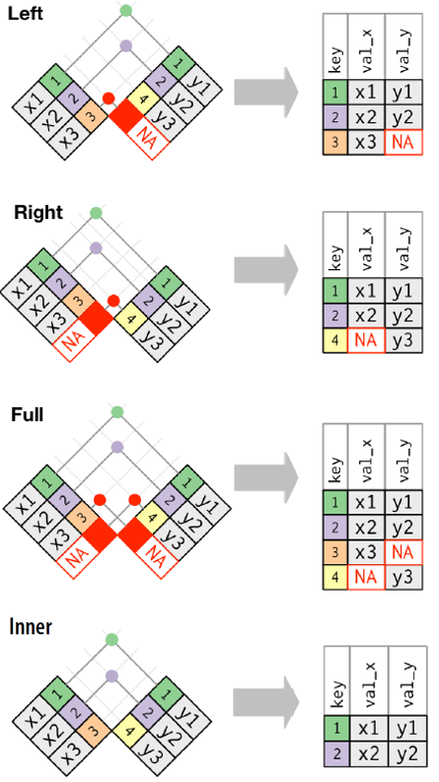
Working with data - handling data
Wickham, H. & Grolemund G., R for Data Science, O’Reilly, 2016

Slide 63
Working with data - handling data
# Patient-level data pDat<-data.frame( name=c("Marc","Ulemu","Clemens","Brigitte"), age=c(37,48,46,38), drug=c("Lariam","Lariam","Malarone","none") )

Slide 64
Working with data - handling data
head(pDat) ## name age drug ## 1 Marc 37 Lariam ## 2 Ulemu 48 Lariam ## 3 Clemens 46 Malarone ## 4 Brigitte 38 none

Slide 65
Working with data - handling data
# Drug-level data dDat<-data.frame( commonName=c("Acticlate","Aralen","Jasoprim","Lariam","Malarone","Malirid","Monodox"), ingredient=c("Doxycycline","Chloroquine","Primaquine","Mefloquine","Atavaquone/Proguanil","Primaquine","Doxycyline") )

Slide 66
Working with data - handling data
head(dDat) ## commonName ingredient ## 1 Acticlate Doxycycline ## 2 Aralen Chloroquine ## 3 Jasoprim Primaquine ## 4 Lariam Mefloquine ## 5 Malarone Atavaquone/Proguanil ## 6 Malirid Primaquine

Slide 67
Working with data - handling data
# Left join pDatWithDrug<-left_join(pDat,dDat,by=c("drug" = "commonName"))

Slide 68
Working with data - handling data
head(pDatWithDrug) ## name age drug ingredient ## 1 Marc 37 Lariam Mefloquine ## 2 Ulemu 48 Lariam Mefloquine ## 3 Clemens 46 Malarone Atavaquone/Proguanil ## 4 Brigitte 38 none <NA>

Slide 69
Working with data - handling data
Pivoting data (wide $→$ long and long $→$ wide)
When data are collected with repeated measurements on the same unit over time or across different conditions (e.g. longitudinal patient data, or before / after data on the same patients), the data can be either in a wide format or a long format.
Depending on what analysis is going to be done, the data may need to be in either of these 2 formats. It is important to be able to switch between both formats when needed.
The package tidyr provides 2 useful functions for this: pivot_longer() and pivot_wider().
Their use is best illustrated with an example.

Slide 70
Working with data - handling data
datWide <- read.table(header=TRUE, text=' subject sex control cond1 cond2 1 M 7.9 12.3 10.7 2 F 6.3 10.6 11.1 3 F 9.5 13.1 13.8 4 M 11.5 13.4 12.9 ') datWide$subject <- factor(datWide$subject)

Slide 71
Working with data - handling data
print(datWide) ## subject sex control cond1 cond2 ## 1 1 M 7.9 12.3 10.7 ## 2 2 F 6.3 10.6 11.1 ## 3 3 F 9.5 13.1 13.8 ## 4 4 M 11.5 13.4 12.9

Slide 72
Working with data - handling data
This is the wide format: 1 individual per row, multiple observations of the same variable under different conditions or fixed timepoints.
Wide to long: pivot_longer()
datLong<-pivot_longer(datWide,cols=c(control,cond1,cond2),names_to="condition",values_to="measurement")

Slide 73
Working with data - handling data
print(datLong) ## # A tibble: 12 × 4 ## subject sex condition measurement ## <fct> <chr> <chr> <dbl> ## 1 1 M control 7.9 ## 2 1 M cond1 12.3 ## 3 1 M cond2 10.7 ## 4 2 F control 6.3 ## 5 2 F cond1 10.6 ## 6 2 F cond2 11.1 ## 7 3 F control 9.5 ## 8 3 F cond1 13.1 ## 9 3 F cond2 13.8 ## 10 4 M control 11.5 ## 11 4 M cond1 13.4 ## 12 4 M cond2 12.9

Slide 74
Working with data - handling data
Long to wide: pivot_wider()
pivot_wider(data=datLong,names_from=condition,values_from=measurement) ## # A tibble: 4 × 5 ## subject sex control cond1 cond2 ## <fct> <chr> <dbl> <dbl> <dbl> ## 1 1 M 7.9 12.3 10.7 ## 2 2 F 6.3 10.6 11.1 ## 3 3 F 9.5 13.1 13.8 ## 4 4 M 11.5 13.4 12.9

Slide 75
Working with data - handling data
Notes:
If you have longitudinal data with variable time points, you can only use the long format.
The base R package stats also provides a function that allows switching between long and wide formats: reshape(). You can explore this function by yourself (type ?reshape at the R console to open the documentation page for it), but generally the use of pivot_longer() and pivot_wider() is more intuitive.

Slide 76
Working with data - handling data
Sometimes packages compete which other.
For example, a filter() function can be found in at least these 3 packages:
stats
dplyr
mice
Likewise, a select() function can be found in at least these 2 packages:
MASS
dplyr
To avoid confusion and mistakes, it is often better to clarify which package you refer to. You do this by pre-pending the package name in front of the function name:
dplyr::filter()
dplyr::select()
mice::filter()

Slide 77
R programming / coding

Slide 78
Coding
Coding

Slide 79
Coding - R functions
When you need to do a given set of commands over and over again, it may be more efficient to group them in an R function - it avoids you to write repetitive code.
To define a function you need to use the R function function(). Inside the brackets you then specify the input arguments to the function you define. The body of code for the function follows in curly brackets after the call to function.
On the next slide is an example where we define a new function, summaryFunction(), that will compute the mean and standard deviation of a specific variable in a data frame and returns this as a list of length 2.

Slide 80
Coding - R functions
summaryFunction<-function(dat,var){ # dat = a data frame # var = a character string indicating the name of the variable in the dat data frame that is to be summarised m<-mean(dat[,var]) s<-sd(dat[,var]) return(list(mean=m,sd=s)) }

Slide 81
Coding - R functions
summaryFunction(dat=iris,var="Sepal.Width") ## $mean ## [1] 3.057333 ## ## $sd ## [1] 0.4358663

Slide 82
Coding - for loops, if statements
A key concept in most programming languages are mechanisms to iterate a set of instructions and to control the execution of parts of the code. There are many of these in R, but we will focus on 2 key concepts here:
for loops - to iterate a section of code over a vector, data frame or list
if statements - to write sections of code that are only run conditional on certain condition(s) to be met

Slide 83
Coding - for loops, if statements
# create an empty vector of the desired size flowerSize<-rep(NA,nrow(iris)) # iterate over all rows of the iris data frame for(i in 1:nrow(iris)){ flowerSize[i]<-iris$Petal.Length[i]+iris$Petal.Width[i]+iris$Sepal.Length[i]+iris$Sepal.Width[i] } irisNew4<-cbind(iris,flowerSize)

Slide 84
Coding - for loops, if statements
head(irisNew4) ## Sepal.Length Sepal.Width Petal.Length Petal.Width Species flowerSize ## 1 5.1 3.5 1.4 0.2 setosa 10.2 ## 2 4.9 3.0 1.4 0.2 setosa 9.5 ## 3 4.7 3.2 1.3 0.2 setosa 9.4 ## 4 4.6 3.1 1.5 0.2 setosa 9.4 ## 5 5.0 3.6 1.4 0.2 setosa 10.2 ## 6 5.4 3.9 1.7 0.4 setosa 11.4

Slide 85
Coding - for loops, if statements
for loops are slow in R. Whenever possible, attempt to vectorise your operations.
# what we've just done forLoop<-function(){ flowerSize<-rep(NA,nrow(iris)) for(i in 1:nrow(iris)){ flowerSize[i]<-iris$Petal.Length[i]+iris$Petal.Width[i]+iris$Sepal.Length[i]+iris$Sepal.Width[i] } }

Slide 86
Coding - for loops, if statements
# same operation but vectorised vectorOperation<-function(){ flowerSize<-iris$Petal.Length+iris$Petal.Width+iris$Sepal.Length+iris$Sepal.Width }

Slide 87
Coding - for loops, if statements
system.time(forLoop()) ## user system elapsed ## 0.002 0.000 0.003 system.time(vectorOperation()) ## user system elapsed ## 0 0 0

Slide 88
Parameter estimation / summary statistics (primer)

Slide 89
Parameter estimation / summary statistics
Proportions

Slide 90
Parameter estimation / summary statistics
The function binom.test() allows you to easily compute proportion estimates and exact binomial 95% confidence intervals:
propEst<-binom.test(x=sum(dat$Species=="setosa"),n=nrow(dat)) propEst$estimate ## probability of success ## 0.3333333 propEst$conf.int ## [1] 0.2585564 0.4148430 ## attr(,"conf.level") ## [1] 0.95

Slide 91
Parameter estimation / summary statistics
Formatting this nicely and expressing it as percentages:
propNice<-paste(sep="", format(nsmall=1,round(digits=1,100*propEst$estimate)), "% (", format(nsmall=1,round(digits=1,100*propEst$conf.int[1])), "%, ", format(nsmall=1,round(digits=1,100*propEst$conf.int[2])), "%)") cat(propNice,file="") ## 33.3% (25.9%, 41.5%)

Slide 92
Parameter estimation / summary statistics
Means, standard deviations

Slide 93
Parameter estimation / summary statistics
To compute an arithmetic mean, the R function mean() can be used and for standard deviations the function sd() is used.
mu<-mean(dat$Petal.Length,na.rm=TRUE) sigma<-sd(dat$Petal.Length,na.rm=TRUE) sigma2<-sigma^2 # same as sigma2<-var(dat$Petal.Length,na.rm=TRUE) n<-sum(!is.na(dat$Petal.Length)) ci<-c( mu - qnorm(0.975)*sigma/sqrt(n), mu + qnorm(0.975)*sigma/sqrt(n) )

Slide 94
Parameter estimation / summary statistics
print(mu) ## [1] 3.758 print(sigma) ## [1] 1.765298 print(sigma^2) ## [1] 3.116278 print(ci) ## [1] 3.475499 4.040501

Slide 95
Parameter estimation / summary statistics
To compute a median, the function median() is used and for IQRs, use quantile(). You can also use the function iqr() for the latter but this returns the width of the IQR.
me<-median(dat$Petal.Length,na.rm=TRUE) iqr<-quantile(dat$Petal.Length,probs=c(0.25,0.75),na.rm=TRUE)

Slide 96
Parameter estimation / summary statistics
print(me) ## [1] 4.35 print(iqr) ## 25% 75% ## 1.6 5.1

Slide 97
Parameter estimation / summary statistics
Grouping and summarising

Slide 98
Parameter estimation / summary statistics
Often it is easiest to summarise a dataset, when you group observations. The R functions group_by() and summarise() are useful here.
dat %>% group_by(Species) %>% summarise( mean=mean(Petal.Length), median=median(Petal.Length), sd=sd(Petal.Length), q25=quantile(Petal.Length,probs=0.25), q75=quantile(Petal.Length,probs=0.75) ,.groups="drop") ## # A tibble: 3 × 6 ## Species mean median sd q25 q75 ## <chr> <dbl> <dbl> <dbl> <dbl> <dbl> ## 1 setosa 1.46 1.5 0.174 1.4 1.58 ## 2 versicolor 4.26 4.35 0.470 4 4.6 ## 3 virginica 5.55 5.55 0.552 5.1 5.88

Slide 99
Basic figures & graphs

Slide 100
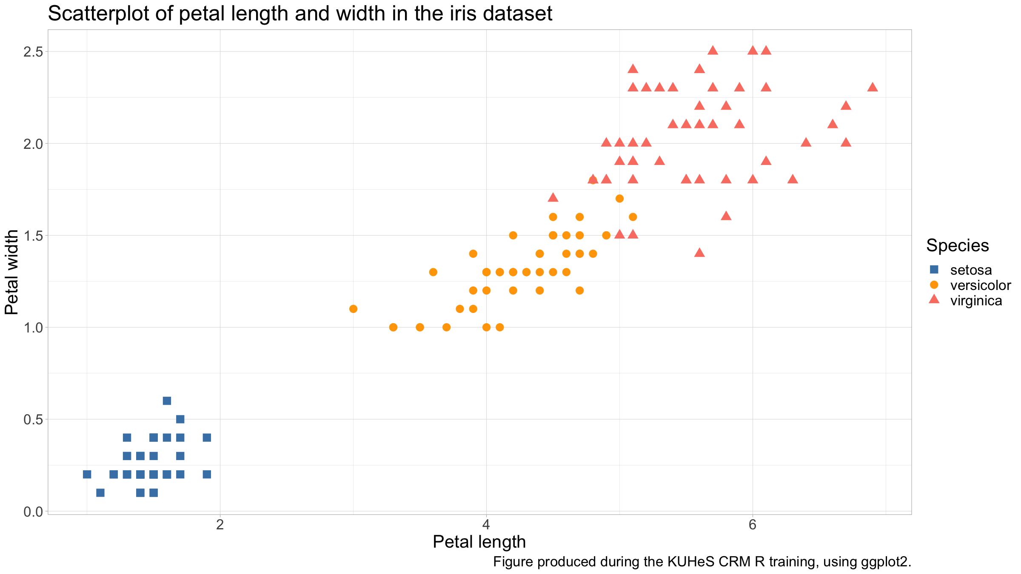
Basic figures & graphs
iris %>% ggplot(mapping=aes(x=Petal.Length,y=Petal.Width,col=Species,pch=Species)) + geom_point() + scale_colour_manual(values=c("steelblue","orange","salmon"),name="Species") + scale_shape_manual(values=15:17,name="Species") + xlab("Petal length") + ylab("Petal width") + labs(title="Scatterplot of petal length and width in the iris dataset",caption="Figure produced during the KUHeS CRM R training, using ggplot2.") + theme_light()

Slide 101
Basic figures & graphs
The aesthetic (the aes() call in the above) defines what you will see, i.e. the data you will plot.
The geom will define the geometry, i.e. how you will plot the data.
The coordinate system governs the data representation.
The theme defines the visual style (background, major & minor axes, font face & size, default colour scales, margins, text alignment, …).

Slide 102
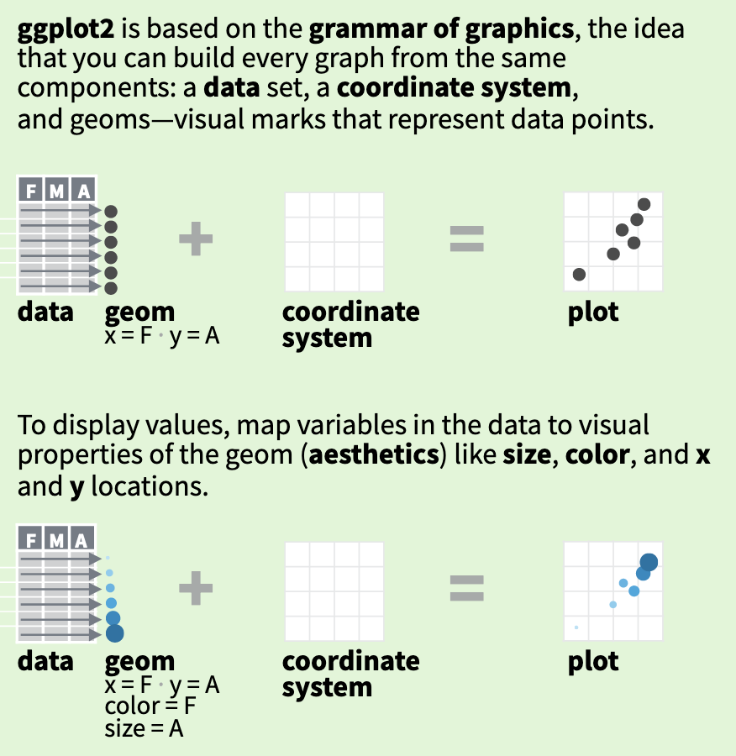
Basic figures & graphs
The basics behind ggplot2 (https://github.com/rstudio/cheatsheets/raw/master/data-visualization.pdf).

Slide 103
Basic figures & graphs
It would not make much sense, but we could decide to plot the same data from before not as a scatterplot but as a line graph.
All we need to do is to change the geom from geom_point() to geom_line().

Slide 104
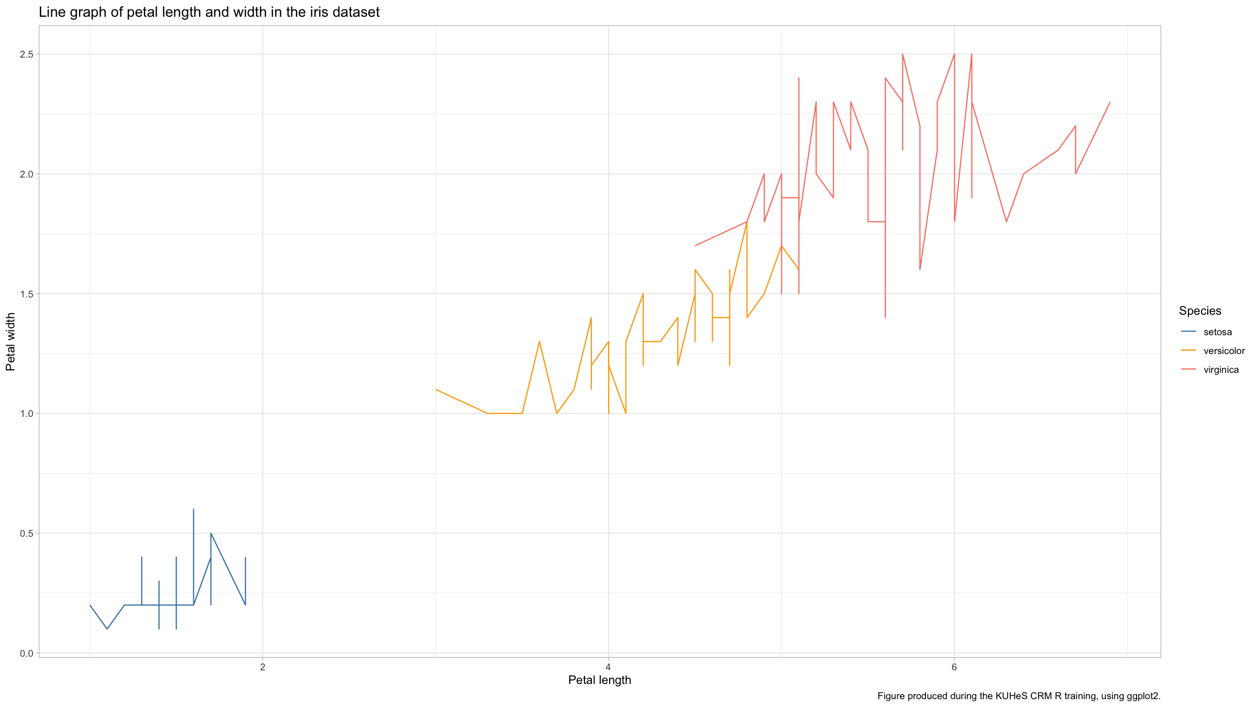
Basic figures & graphs
iris %>% ggplot(mapping=aes(x=Petal.Length,y=Petal.Width,col=Species,pch=Species)) + geom_line() + scale_colour_manual(values=c("steelblue","orange","salmon"),name="Species") + scale_shape_manual(values=15:17,name="Species") + xlab("Petal length") + ylab("Petal width") + labs(title="Line graph of petal length and width in the iris dataset",caption="Figure produced during the KUHeS CRM R training, using ggplot2.") + theme_light()

Slide 105
Basic figures & graphs
Even for very different graphs, there is very similar code to write with ggplot2.
You can also use more than one geom on the same graph.

Slide 106
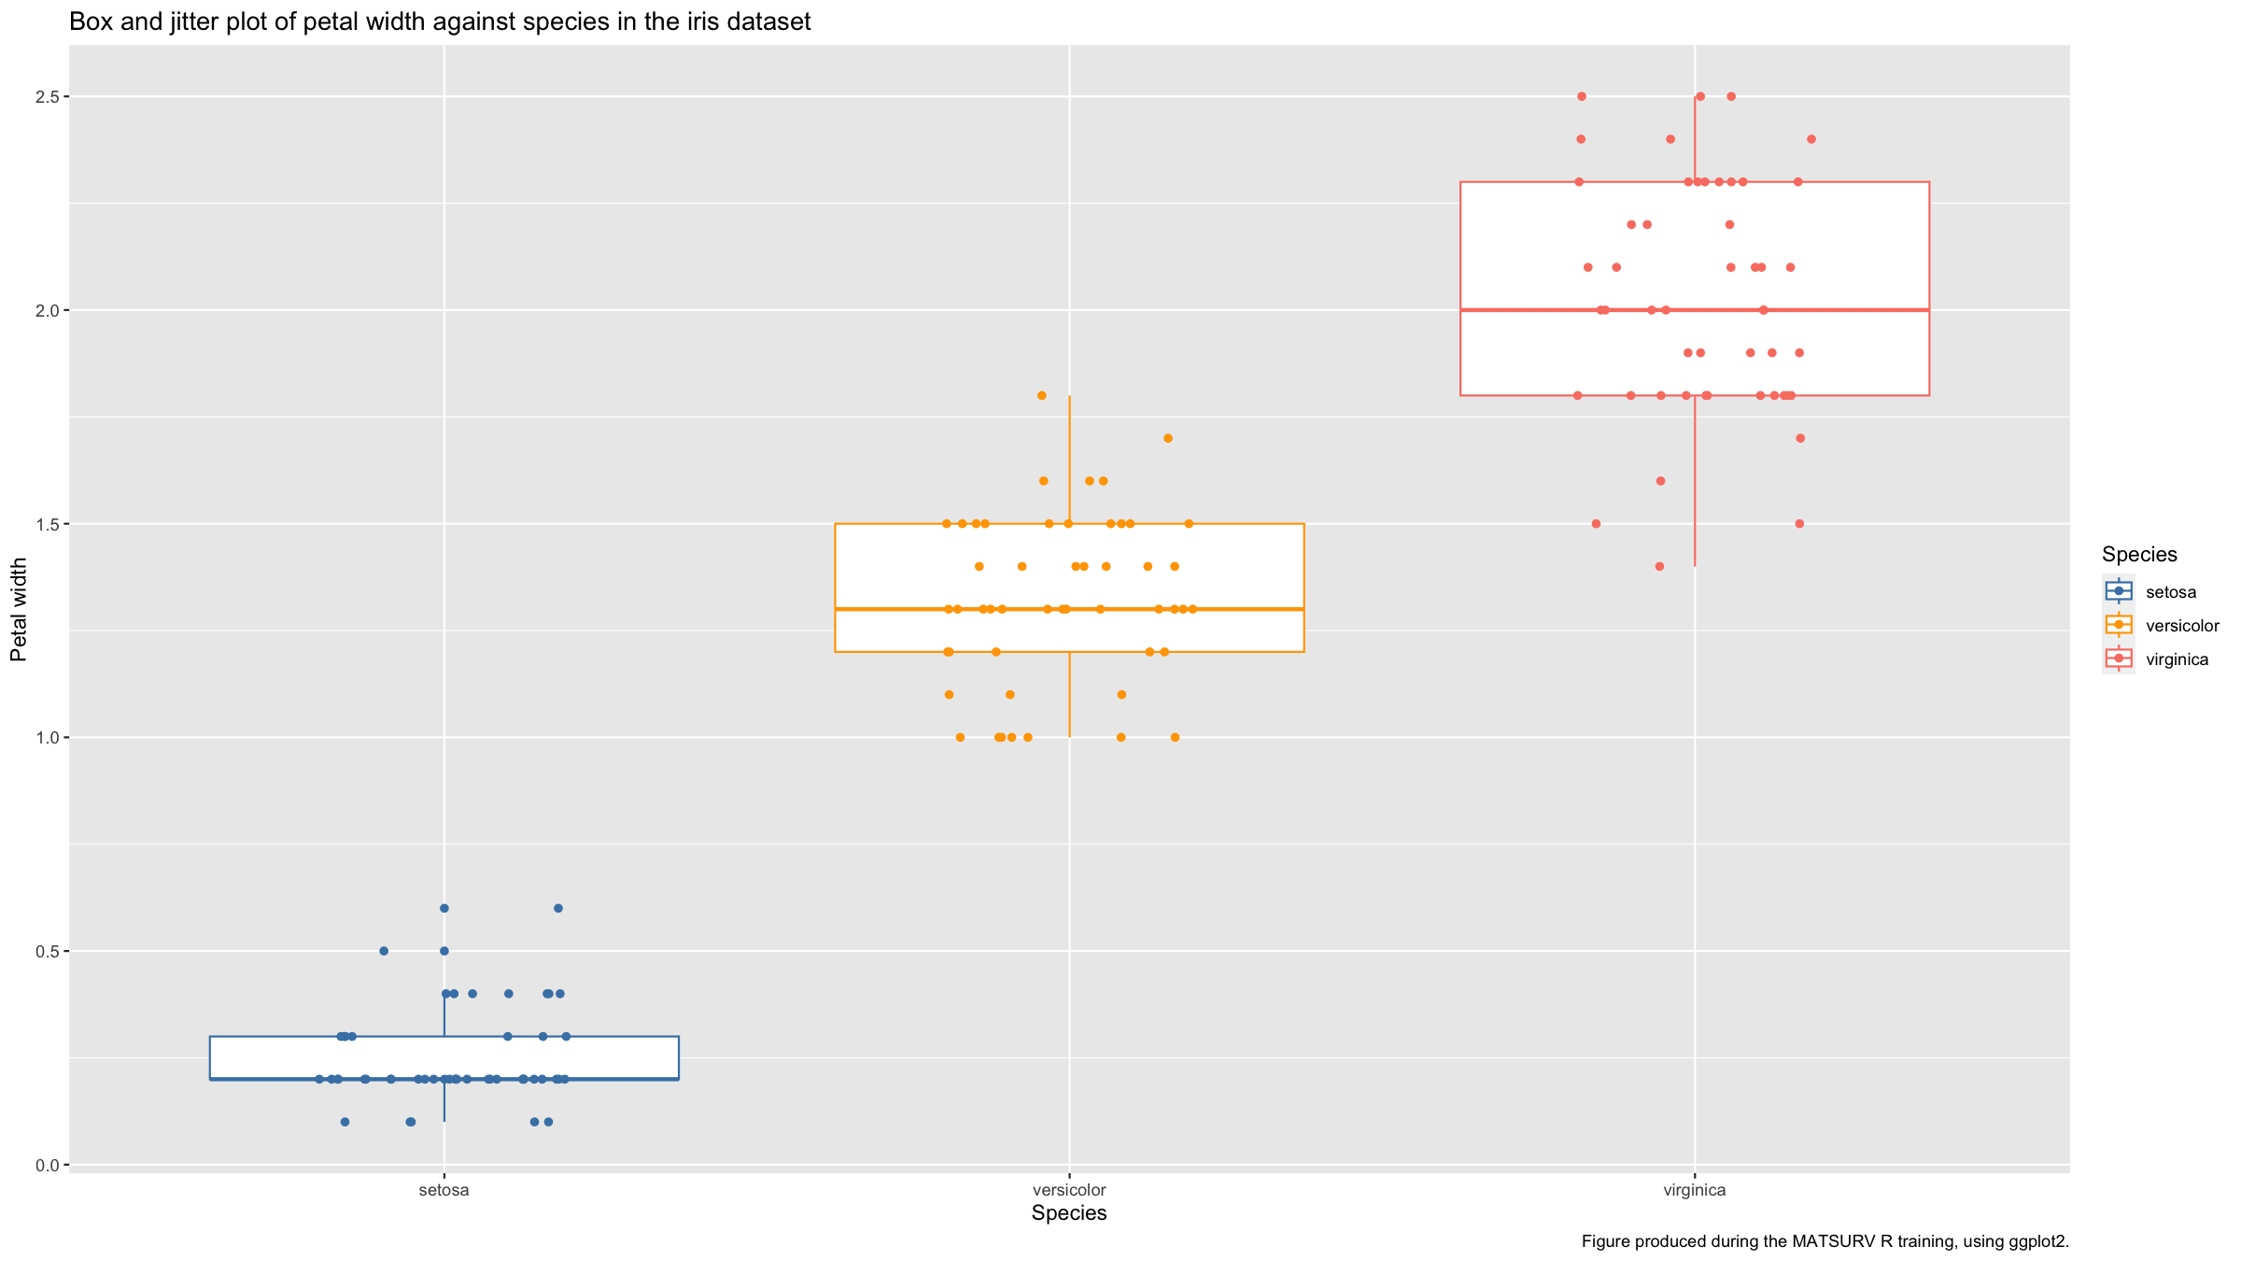
Basic figures & graphs
iris %>% ggplot(mapping=aes(x=Species,y=Petal.Width,col=Species)) + geom_boxplot() + geom_jitter(height=0,width=0.2) + scale_colour_manual(values=c("steelblue","orange","salmon")) + scale_fill_manual(values=c("steelblue","orange","salmon")) + xlab("Species") + ylab("Petal width") + labs(title="Box and jitter plot of petal width against species in the iris dataset",caption="Figure produced during the MATSURV R training, using ggplot2.")

Slide 107
Resources

Slide 108
Resources
The R Graph Gallery is an excellent resource to get started when you have a specific plot in mind that you want to do for your data.
The ggplot2 cheat sheet is another excellent resource.

Slide 109
Distribution figures

Slide 110
Distribution figures
Distributions: what values did you record for a given variable?
Discrete values (nominal, ordinal, integer-valued) values:
bar plots
pie charts
Continuous values
histograms
Let’s generate some data.

Slide 111
Distribution figures
typesTmp<- paste(sep="","type",1:3) type<-factor(sample(typesTmp, size=1000, replace=T, prob=c(0.45,0.3,0.25))) x1<-rbinom(1000,size=1,prob=0.25) x2<-rpois(1000,lambda=ifelse(type=="type3",6,4))

Slide 112
Distribution figures
dat<-data.frame(type,x1,x2) %>% mutate(x3=ifelse(type=="type1", rnorm(sum(type=="type1"),mean=-2), ifelse(type=="type2", rnorm(sum(type=="type2"),mean=2), runif(sum(type=="type3")) ) ) ) %>% mutate(x4=rnorm(n(),mean=x3))

Slide 113
Distribution figures
Bar plots simply show bars the height of which is proportional to the relative frequency of the different levels of a categorical variable in your dataset.
In ggplot2, the geom to use for barplots is geom_barplot().
On the next few slides we generate simple bar plots for 3 variables.

Slide 114
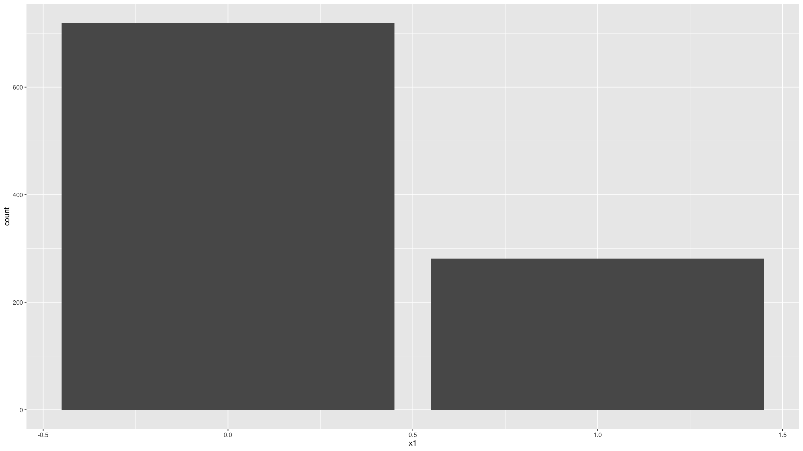
Distribution figures
ggplot(data=dat,mapping=aes(x=x1)) + geom_bar()

Slide 115
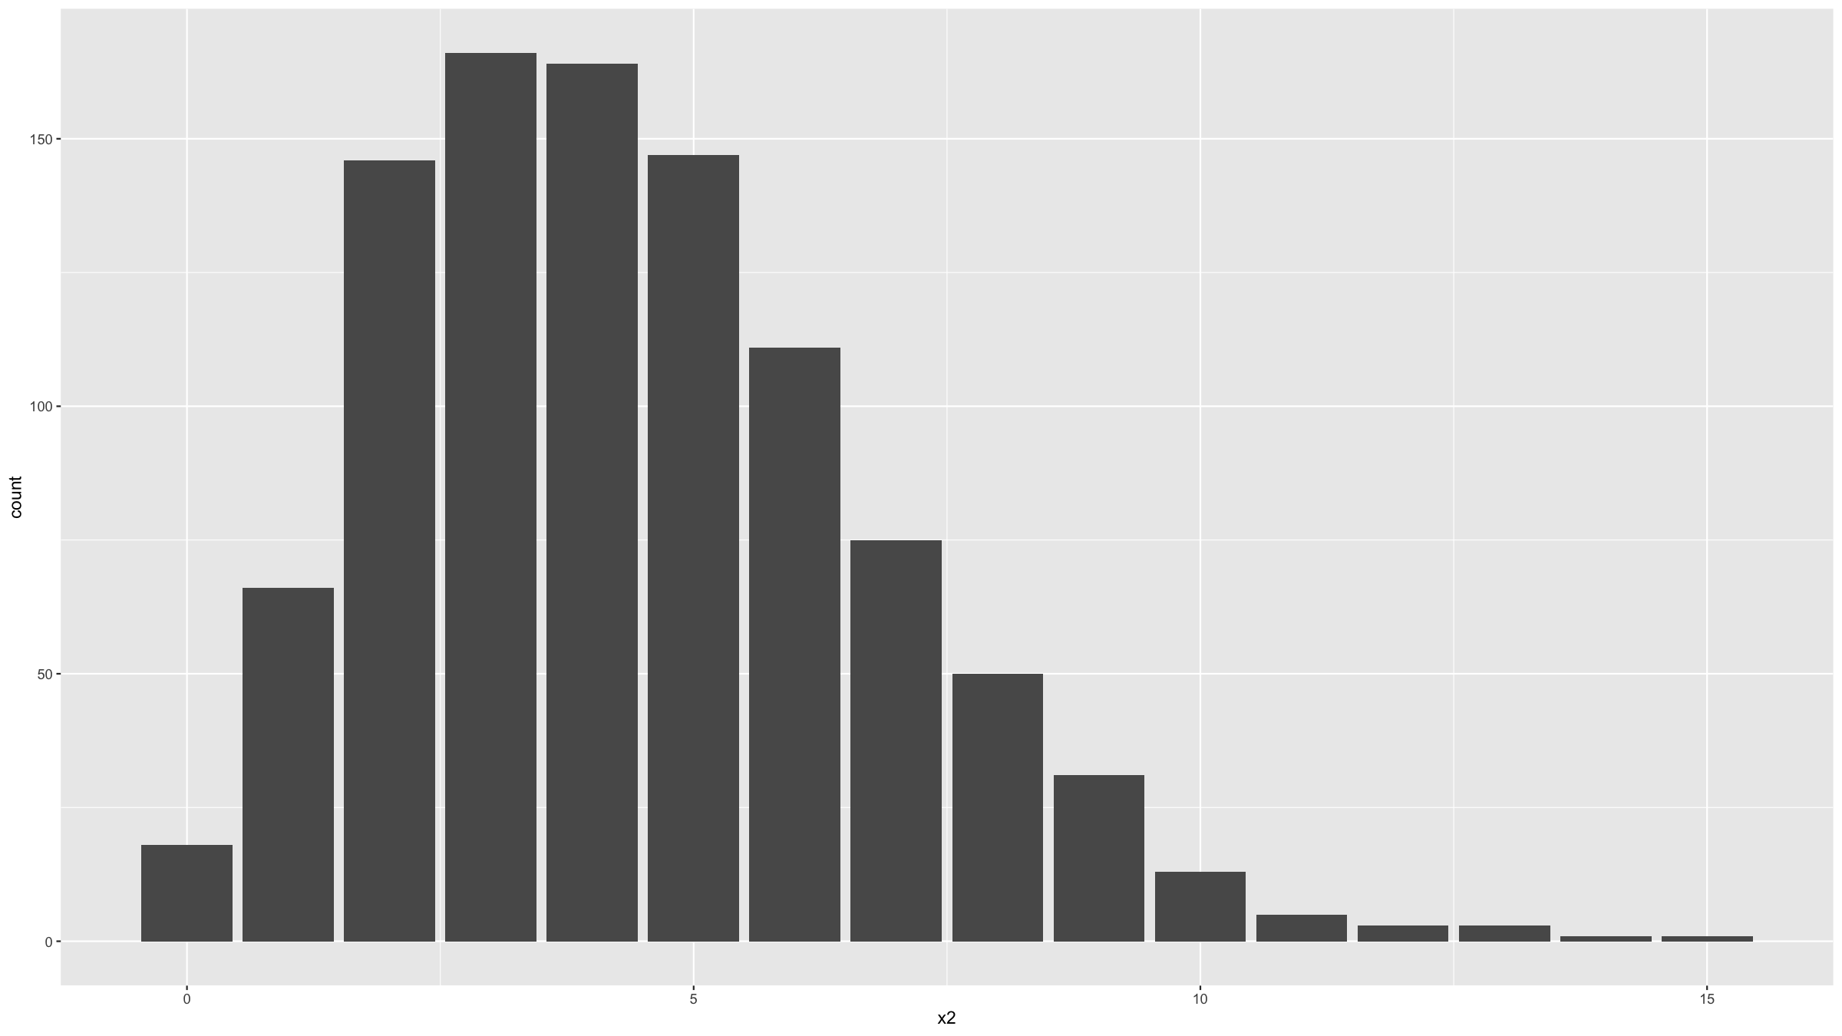
Distribution figures
ggplot(data=dat,mapping=aes(x=x2)) + geom_bar()

Slide 116
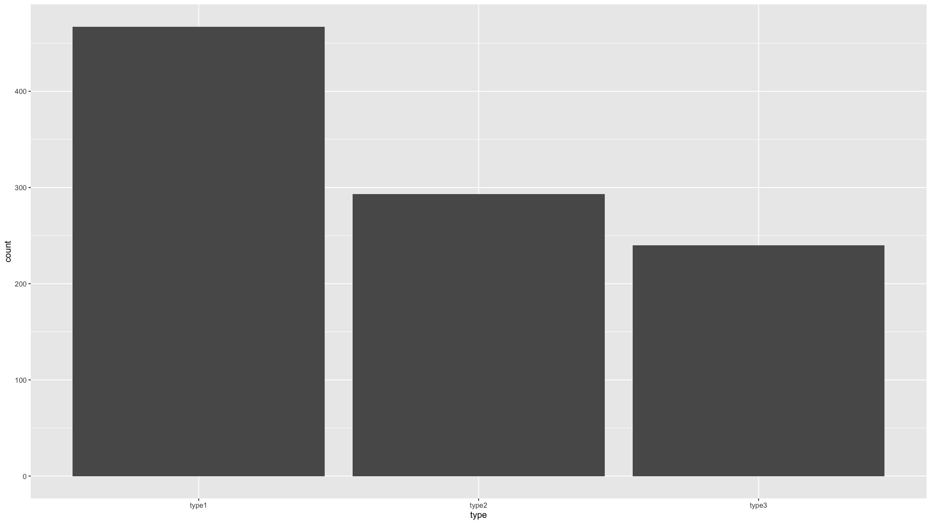
Distribution figures
ggplot(data=dat,mapping=aes(x=type)) + geom_bar()

Slide 117
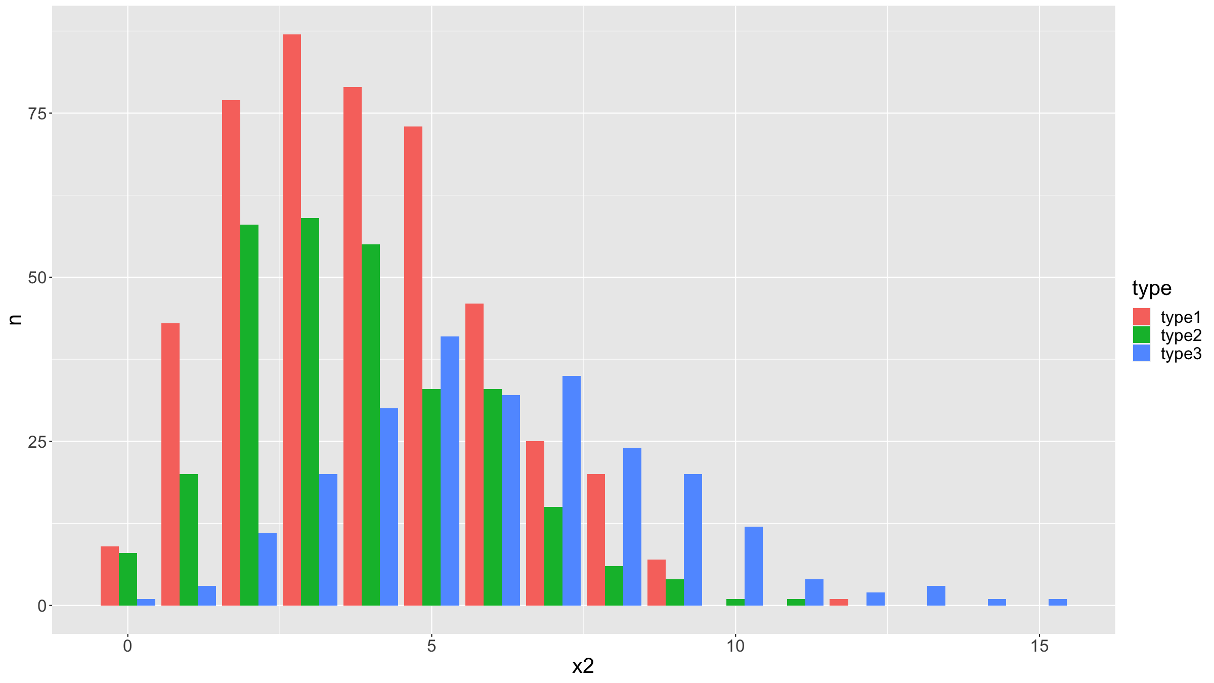
Distribution figures
We can stratify a bar plot by a grouping variable (in this case the variable type).
dat %>% count(type,x2) %>% complete(type,x2,fill=list(n=0)) %>% ggplot(mapping=aes(fill=type,y=n,x=x2)) + geom_bar(position="dodge",stat="identity") + theme(text = element_text(size=20))

Slide 118
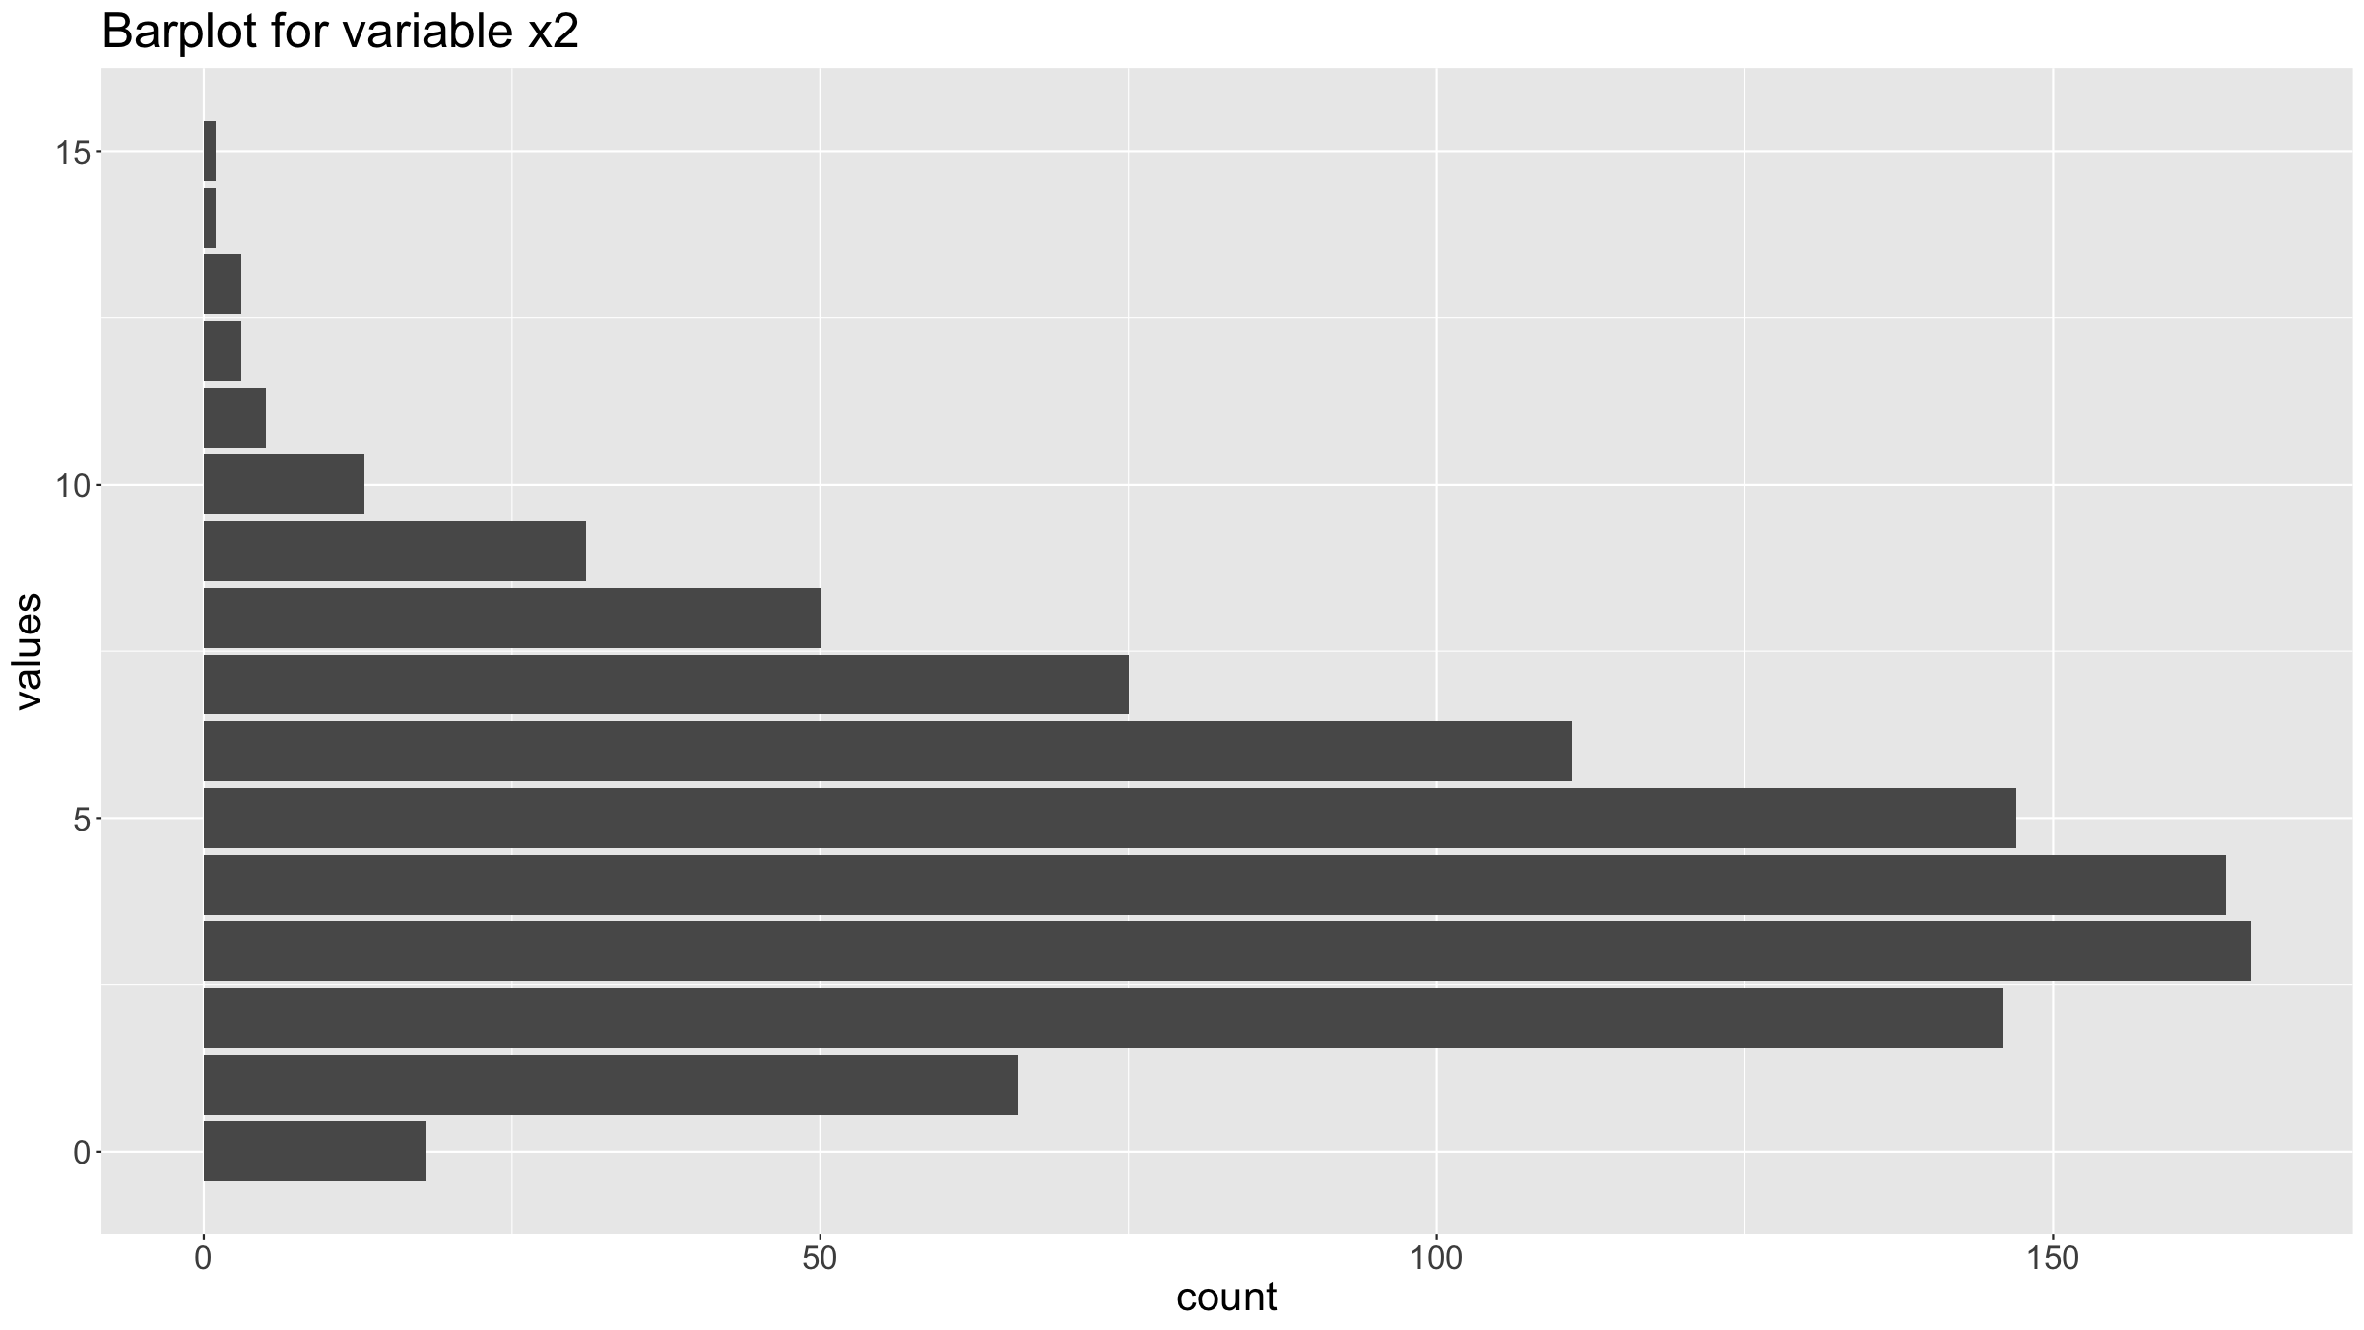
Distribution figures
You can customise graphs by adding other options for the coordinate system, the annotations, the theme etc.
ggplot(data=dat,mapping=aes(x=x2)) + geom_bar() + coord_flip() + ggtitle("Barplot for variable x2") + xlab("values") + ylab("count") + theme(text = element_text(size=20))

Slide 119

Distribution figures
You can change the coordinate system to get a circular plot (note: most often they are NOT a good idea). For this you can use coord_polar().
ggplot(data=dat,mapping=aes(x=x2)) + geom_bar() + coord_polar(start=0) + theme_minimal() + theme( axis.text = element_blank(), axis.title = element_blank(), panel.grid = element_blank(), plot.margin = unit(rep(-2,4), "cm") # removing unnecessary margins ) + ylim(-100,250) # determines size of the inner radius

Slide 120
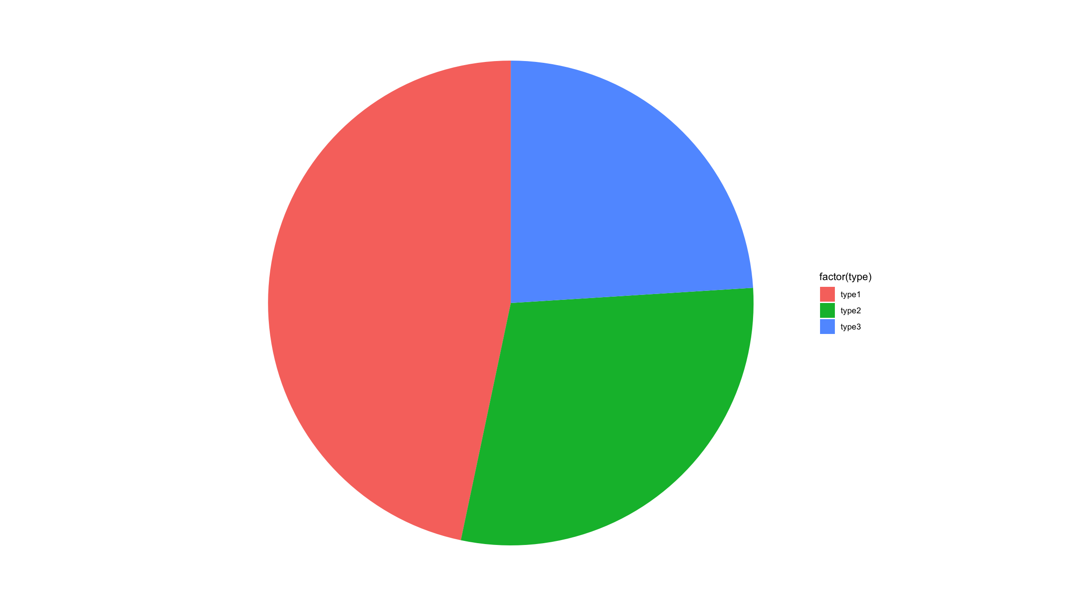
Distribution figures
In ggplot2, pie charts are just bar charts with a special (polar) coordinate system.
Generally, R discourages the use of pie charts (they are horrible & misleading - human brains are not good at judging the relative sizes of areas)
ggplot(dat, mapping=aes(x=factor(1), fill=factor(type))) + geom_bar(width = 1) + coord_polar("y") + xlab("") + theme_void()

Slide 121
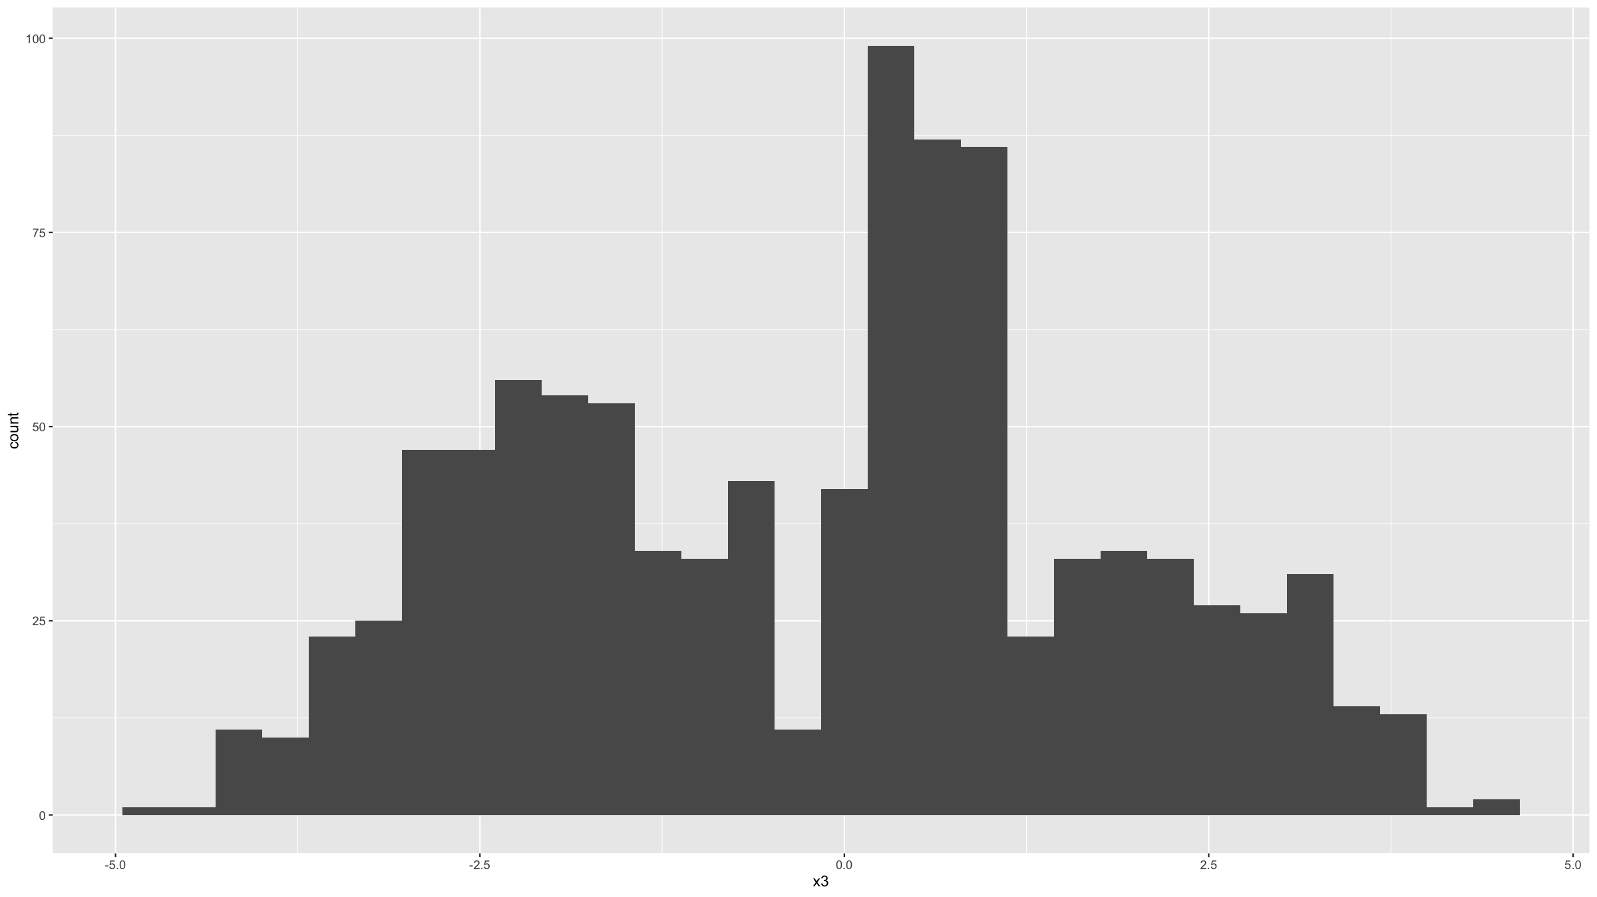
Distribution figures
Histograms are useful graphs. They:
Summarise the distribution of continuous variables, by binning data into discrete intervals.
Can be used for binary and discrete variables as well, but barplots better suited for such variables.
In ggplot2, the geom_histogram() is used to generate histograms.
ggplot(data=dat,mapping=aes(x=x3)) + geom_histogram() ## `stat_bin()` using `bins = 30`. Pick better value with `binwidth`.

Slide 122
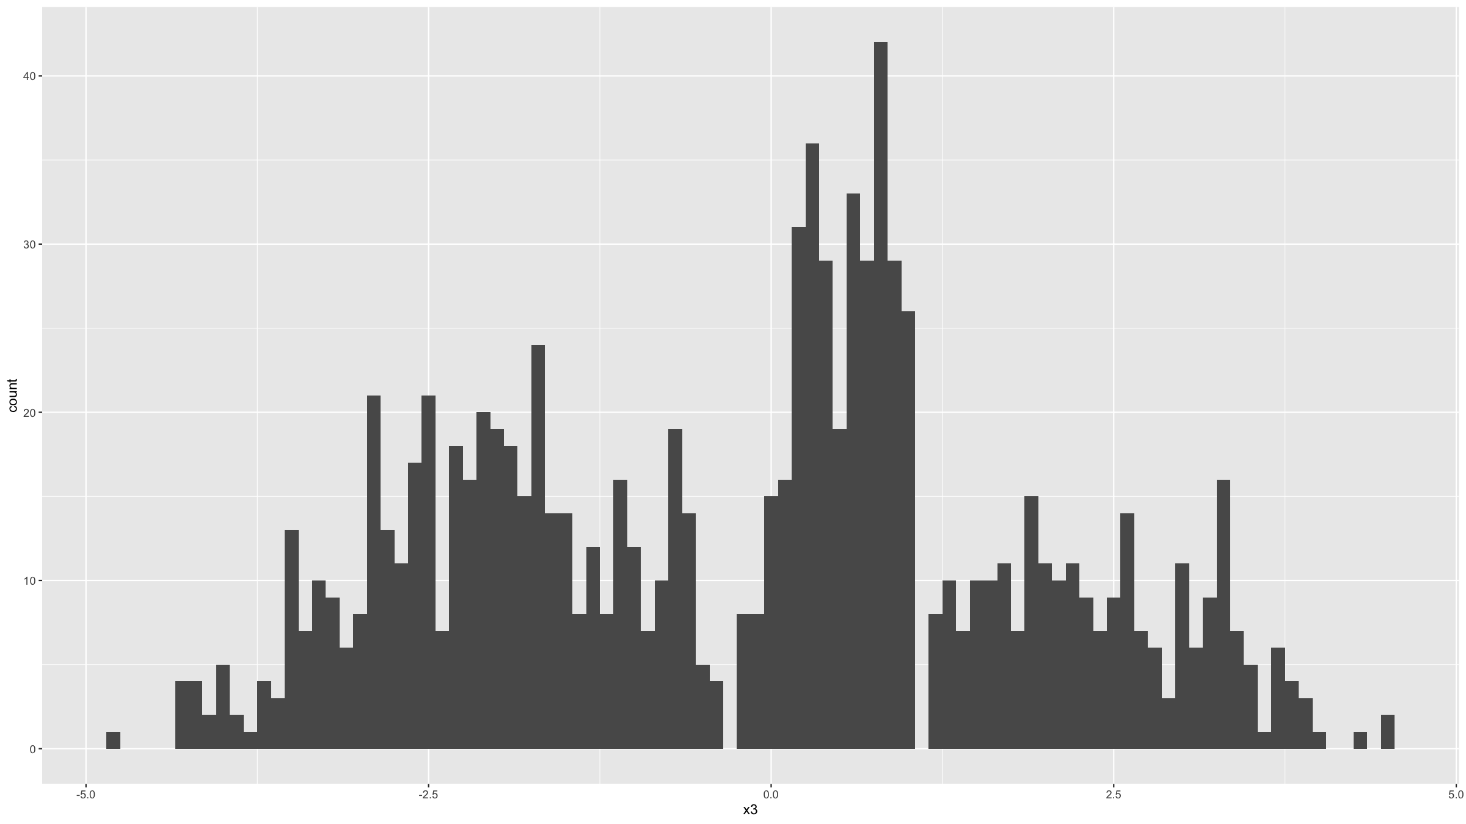
Distribution figures
Note the warning message above. You can ignore this, but R is just trying to tell you that other bin widths / number of bins may work better. You can set this by specifying the bins or the bindwidth parameter.
ggplot(data=dat,mapping=aes(x=x3)) + geom_histogram(binwidth=0.1)

Slide 123
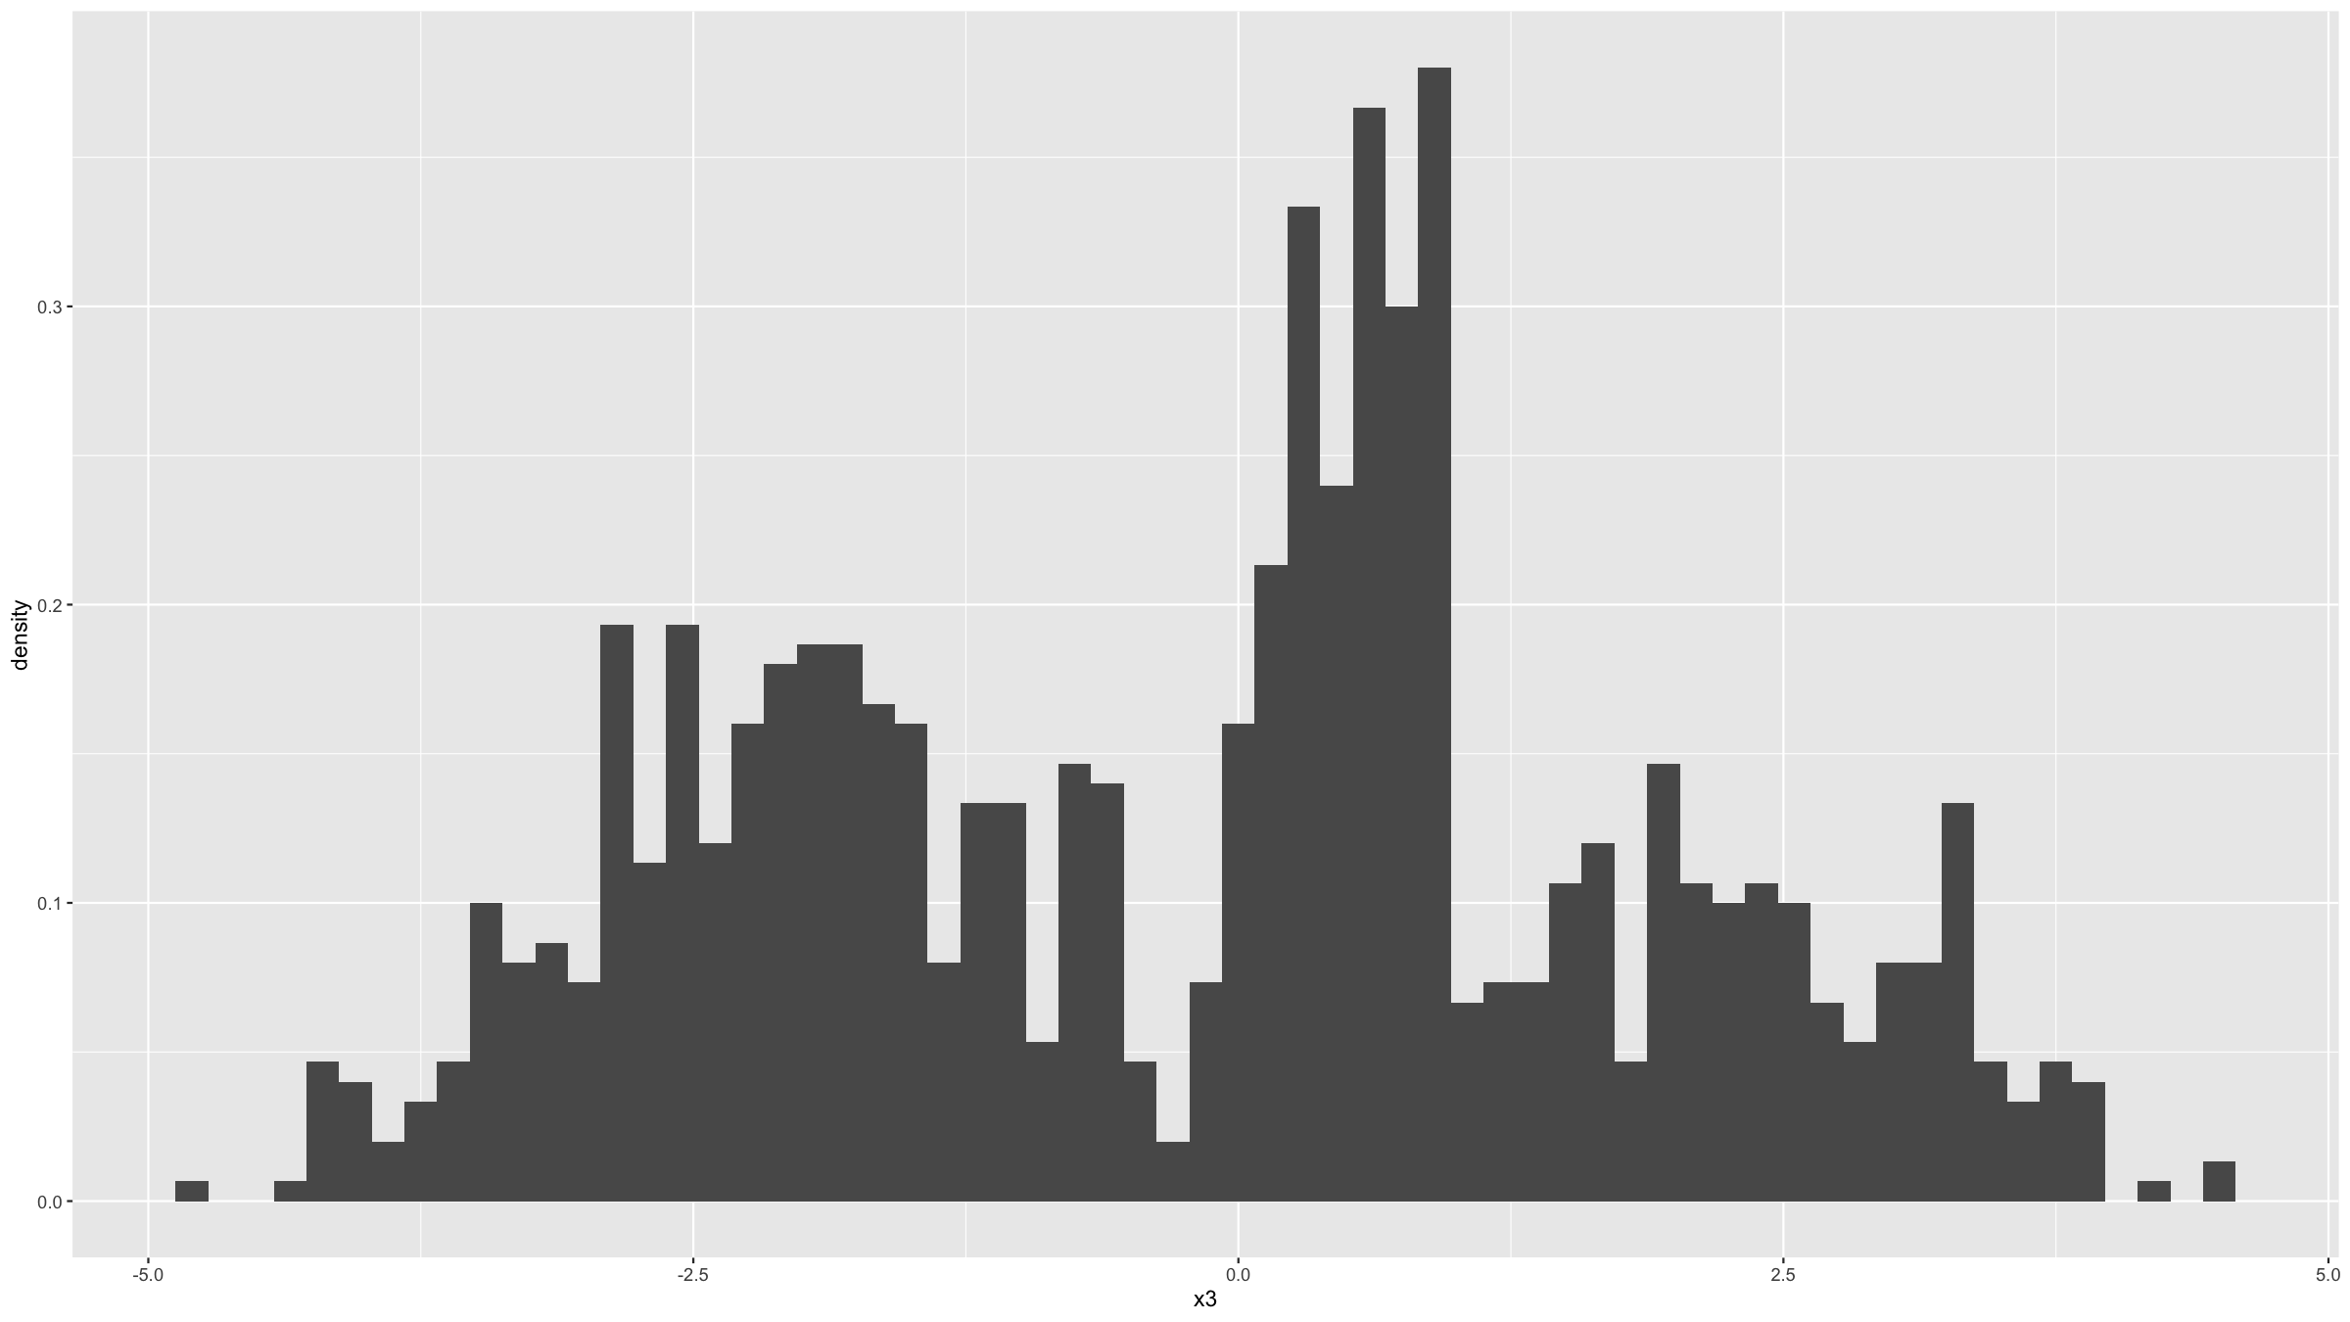
ggplot(data=dat,mapping=aes(x=x3,stat(density))) + geom_histogram(binwidth=0.15) ## Warning: `stat(density)` was deprecated in ggplot2 3.4.0. ## ℹ Please use `after_stat(density)` instead.

Slide 124
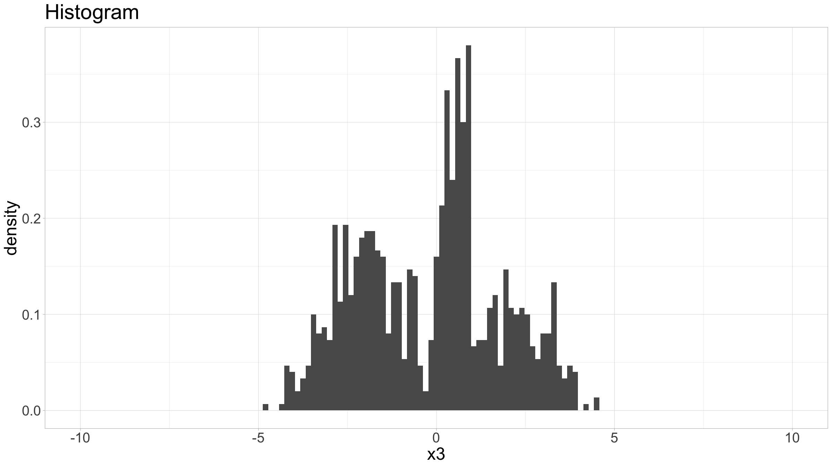
Distribution figures
There’s many other parameters you can specify to customise the histogram graph.
ggplot(data=dat,mapping=aes(x=x3,stat(density))) + geom_histogram(binwidth=0.15) + coord_cartesian(xlim = c(-10, 10)) + ggtitle("Histogram") + theme_light() + theme(text=element_text(size=24))

Slide 125
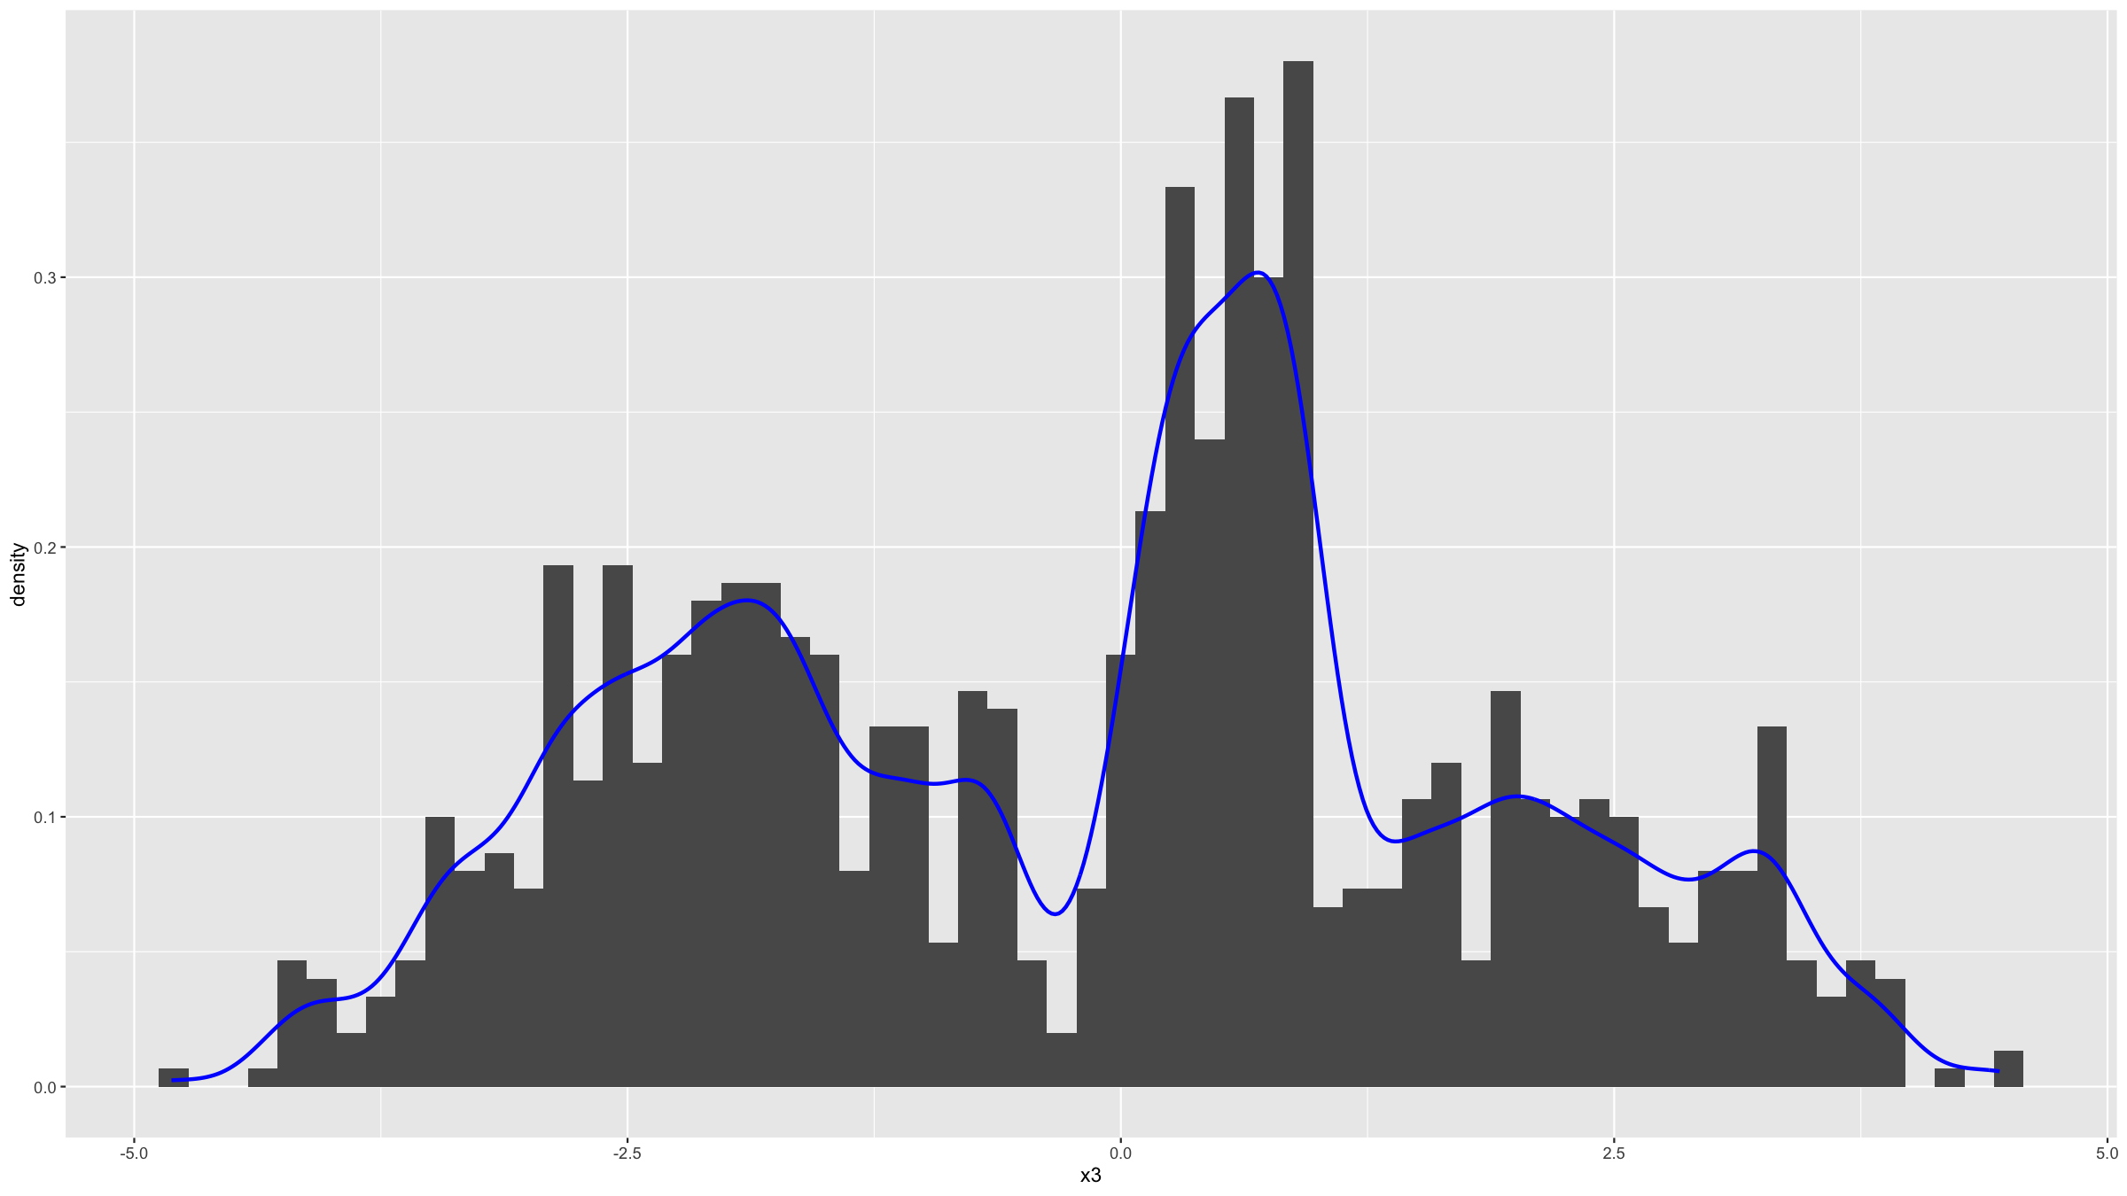
Distribution figures
We can add kernel density estimates for the distribution function.
ggplot(data=dat,mapping=aes(x=x3,stat(density))) + geom_histogram(binwidth=0.15) + geom_density(bw="SJ",col="blue",lwd=1)

Slide 126
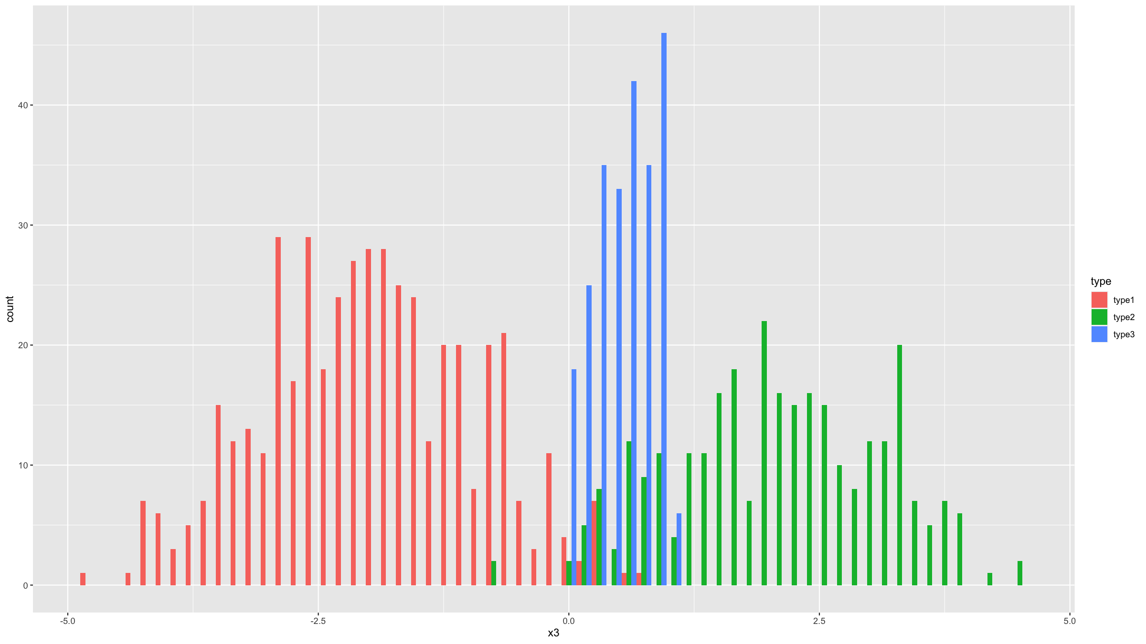
Distribution figures
We can stratify by a grouping variable (variable type in this case).
ggplot(data=dat,mapping=aes(x=x3,fill=type)) + geom_histogram(binwidth=0.15,position="dodge")

Slide 127
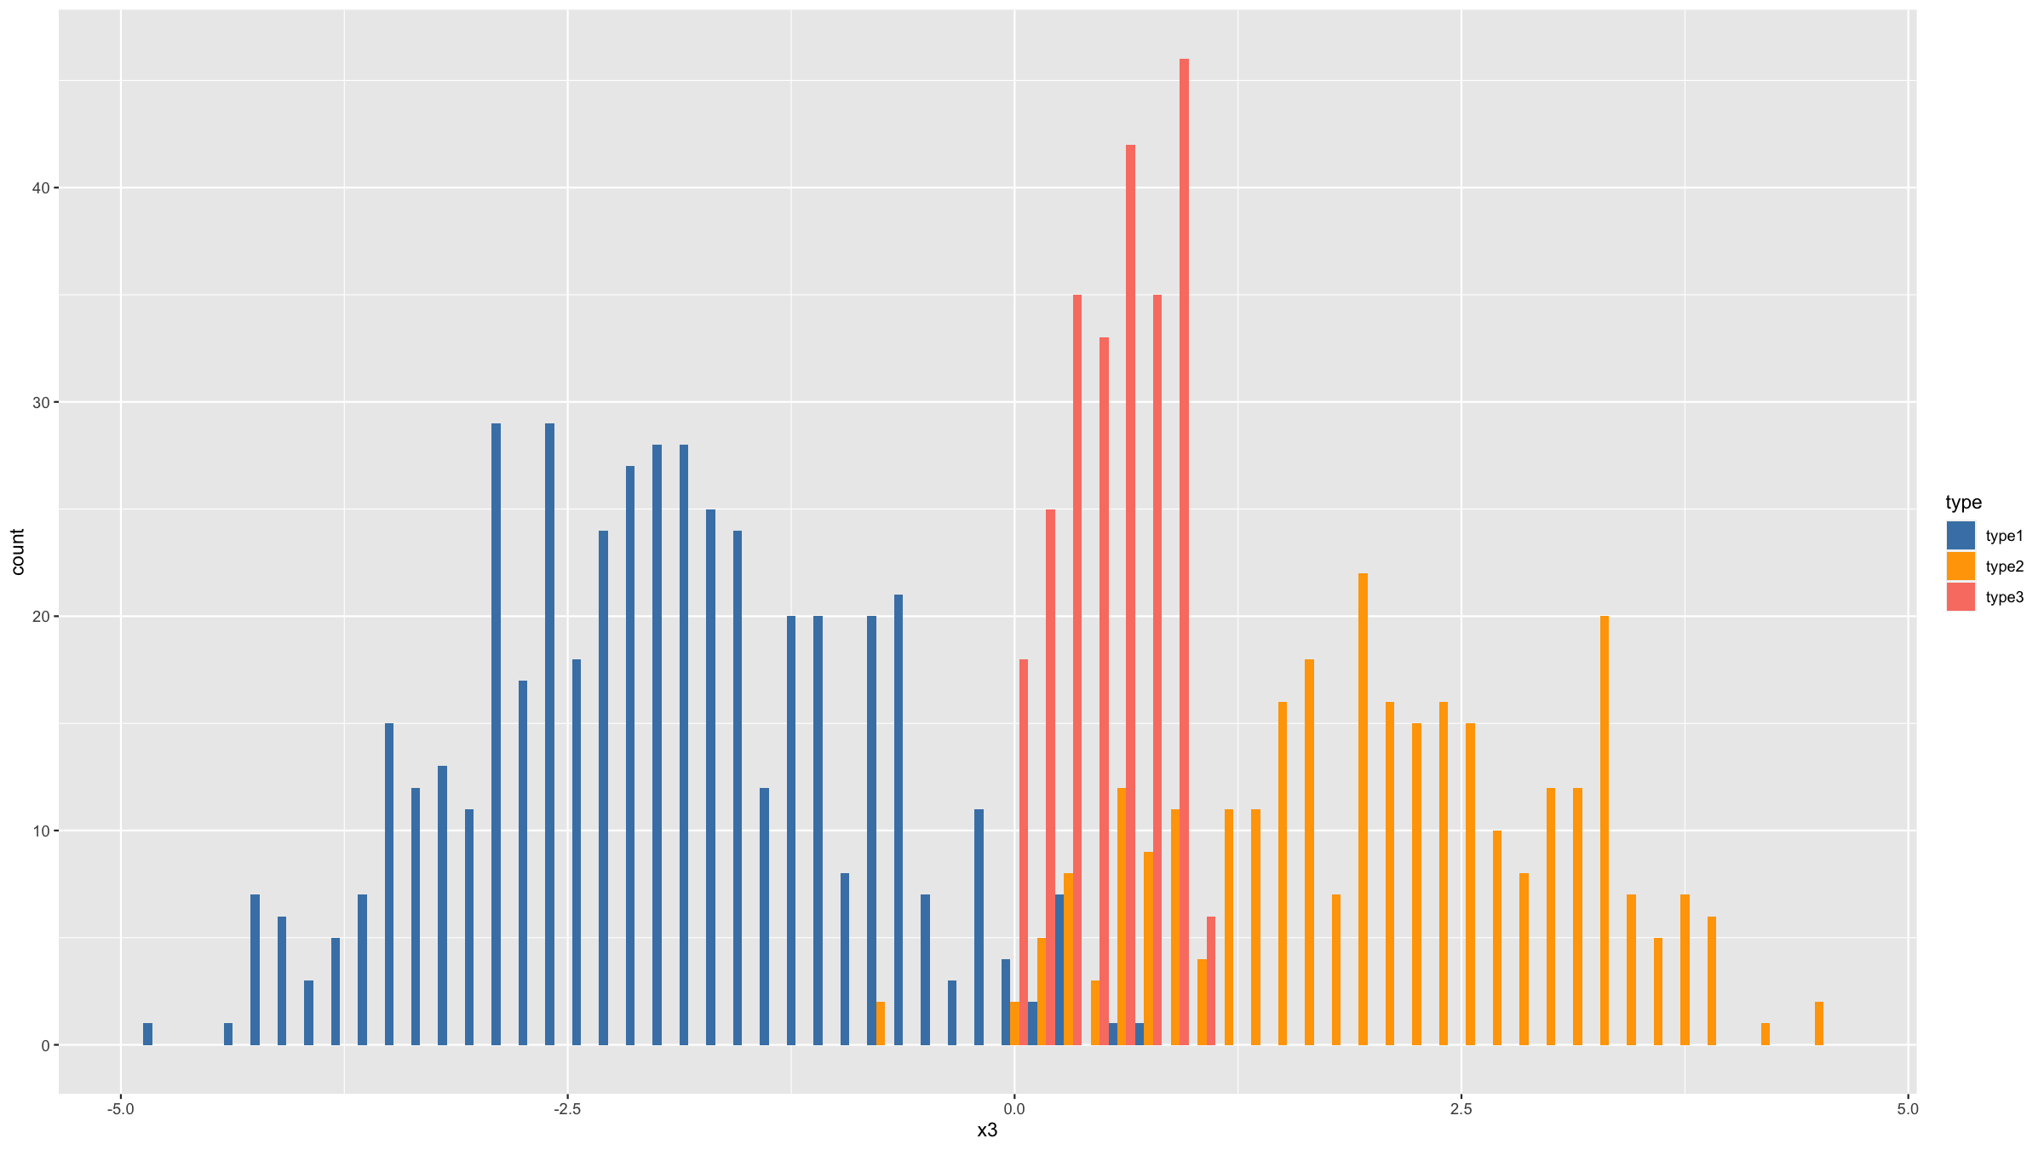
Distribution figures
You can change the default colours that are being used for the type variable.
The aesthetic element governing the colour of the bars is the variable specified by fill=type.
So to change the colours, we need to use the function scale_fill_manual().
ggplot(data=dat,mapping=aes(x=x3,fill=type)) + geom_histogram(binwidth=0.15,position="dodge") + scale_fill_manual(values=c("steelblue","orange","salmon"))

Slide 128
Covariation figures

Slide 129
Covariation figures
Covariation figures let you visually explore whether there is a relationship between 2 or more variables.

Slide 130
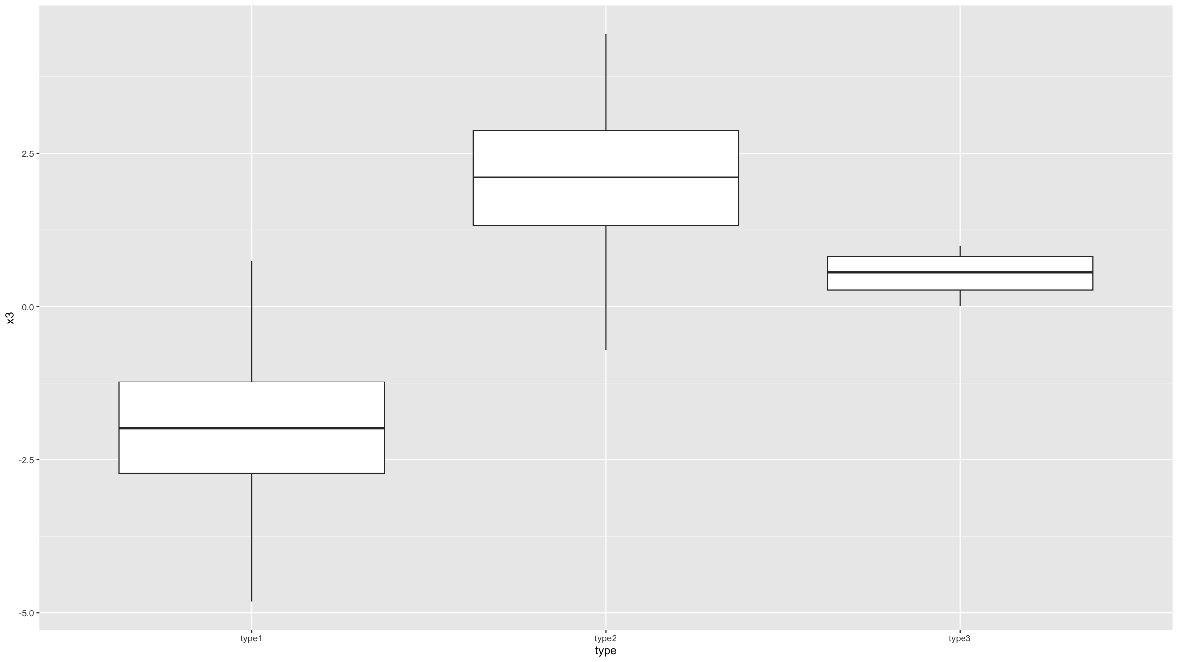
Covariation figures
Boxplots, and their variation violin plots, allow you to explore what, if any, relationship there is between a binary / discrete / categorical and a continuous variable.
For boxplots the geom geom_boxplot() is used is used.
ggplot(data=dat,mapping=aes(x=type,y=x3)) + geom_boxplot()

Slide 131
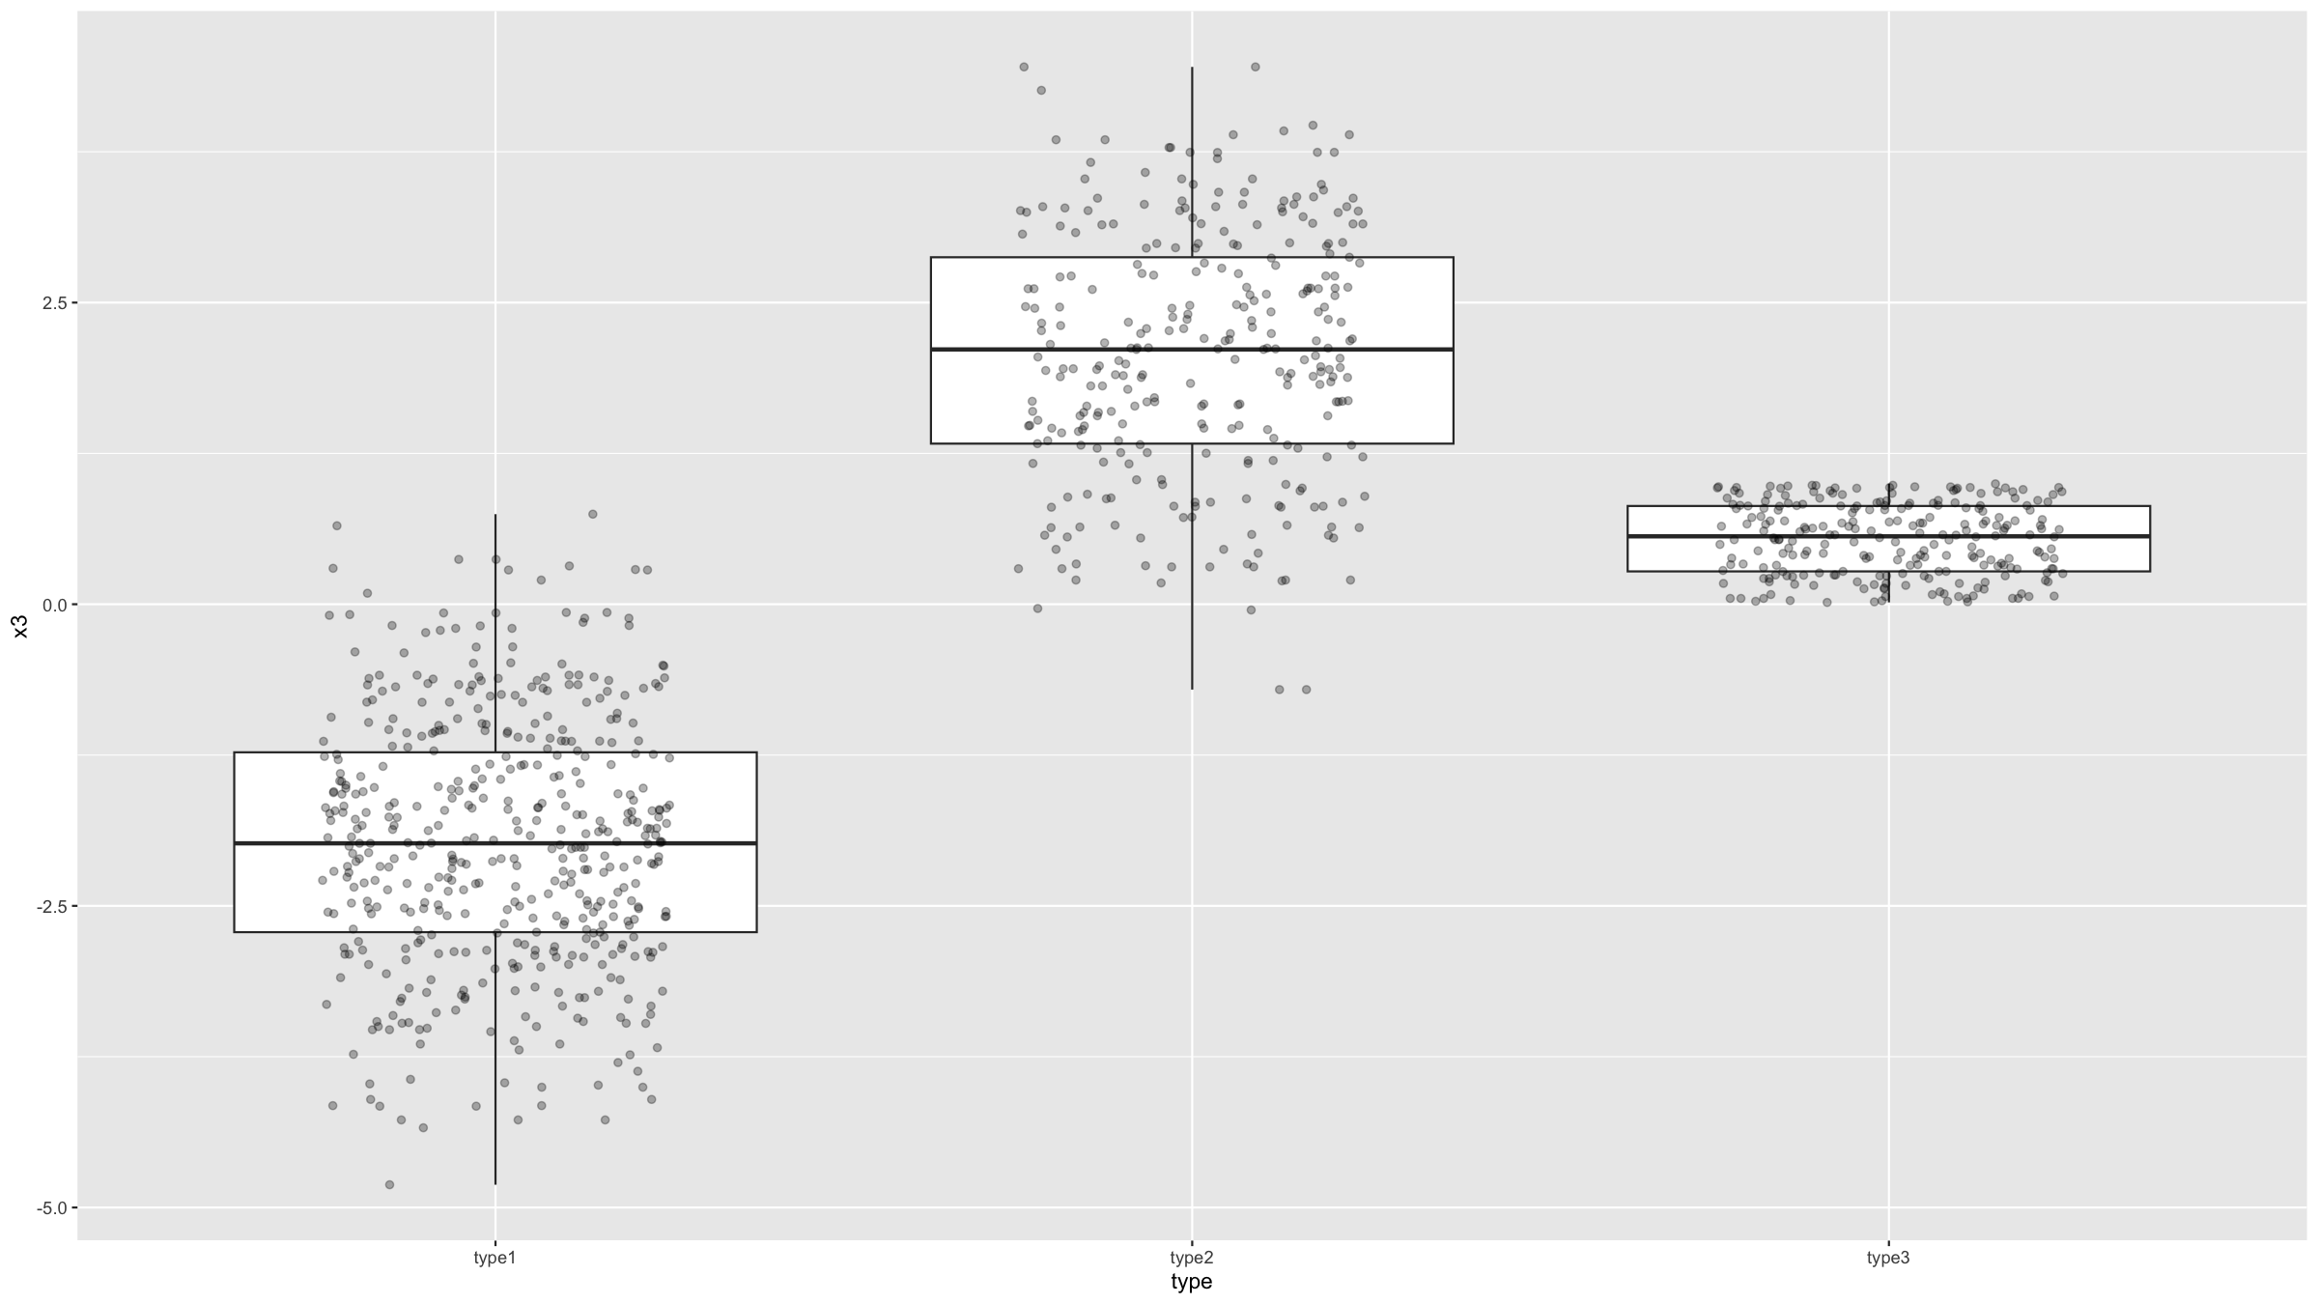
Covariation figures
Often it is nice to add individual data points on top. To better display these (since they all have the same x-axis coordinate), you need to ass jitter to their x-axis coordinates. ggplot2 provides a geom for this: geom_jitter(). By specifying some transparency (the alpha parameter), it is easier to get an idea where the ddata density is highest.
ggplot(data=dat,mapping=aes(x=type,y=x3)) + geom_boxplot() + geom_jitter(width=0.25,height=0,alpha=0.3)

Slide 132
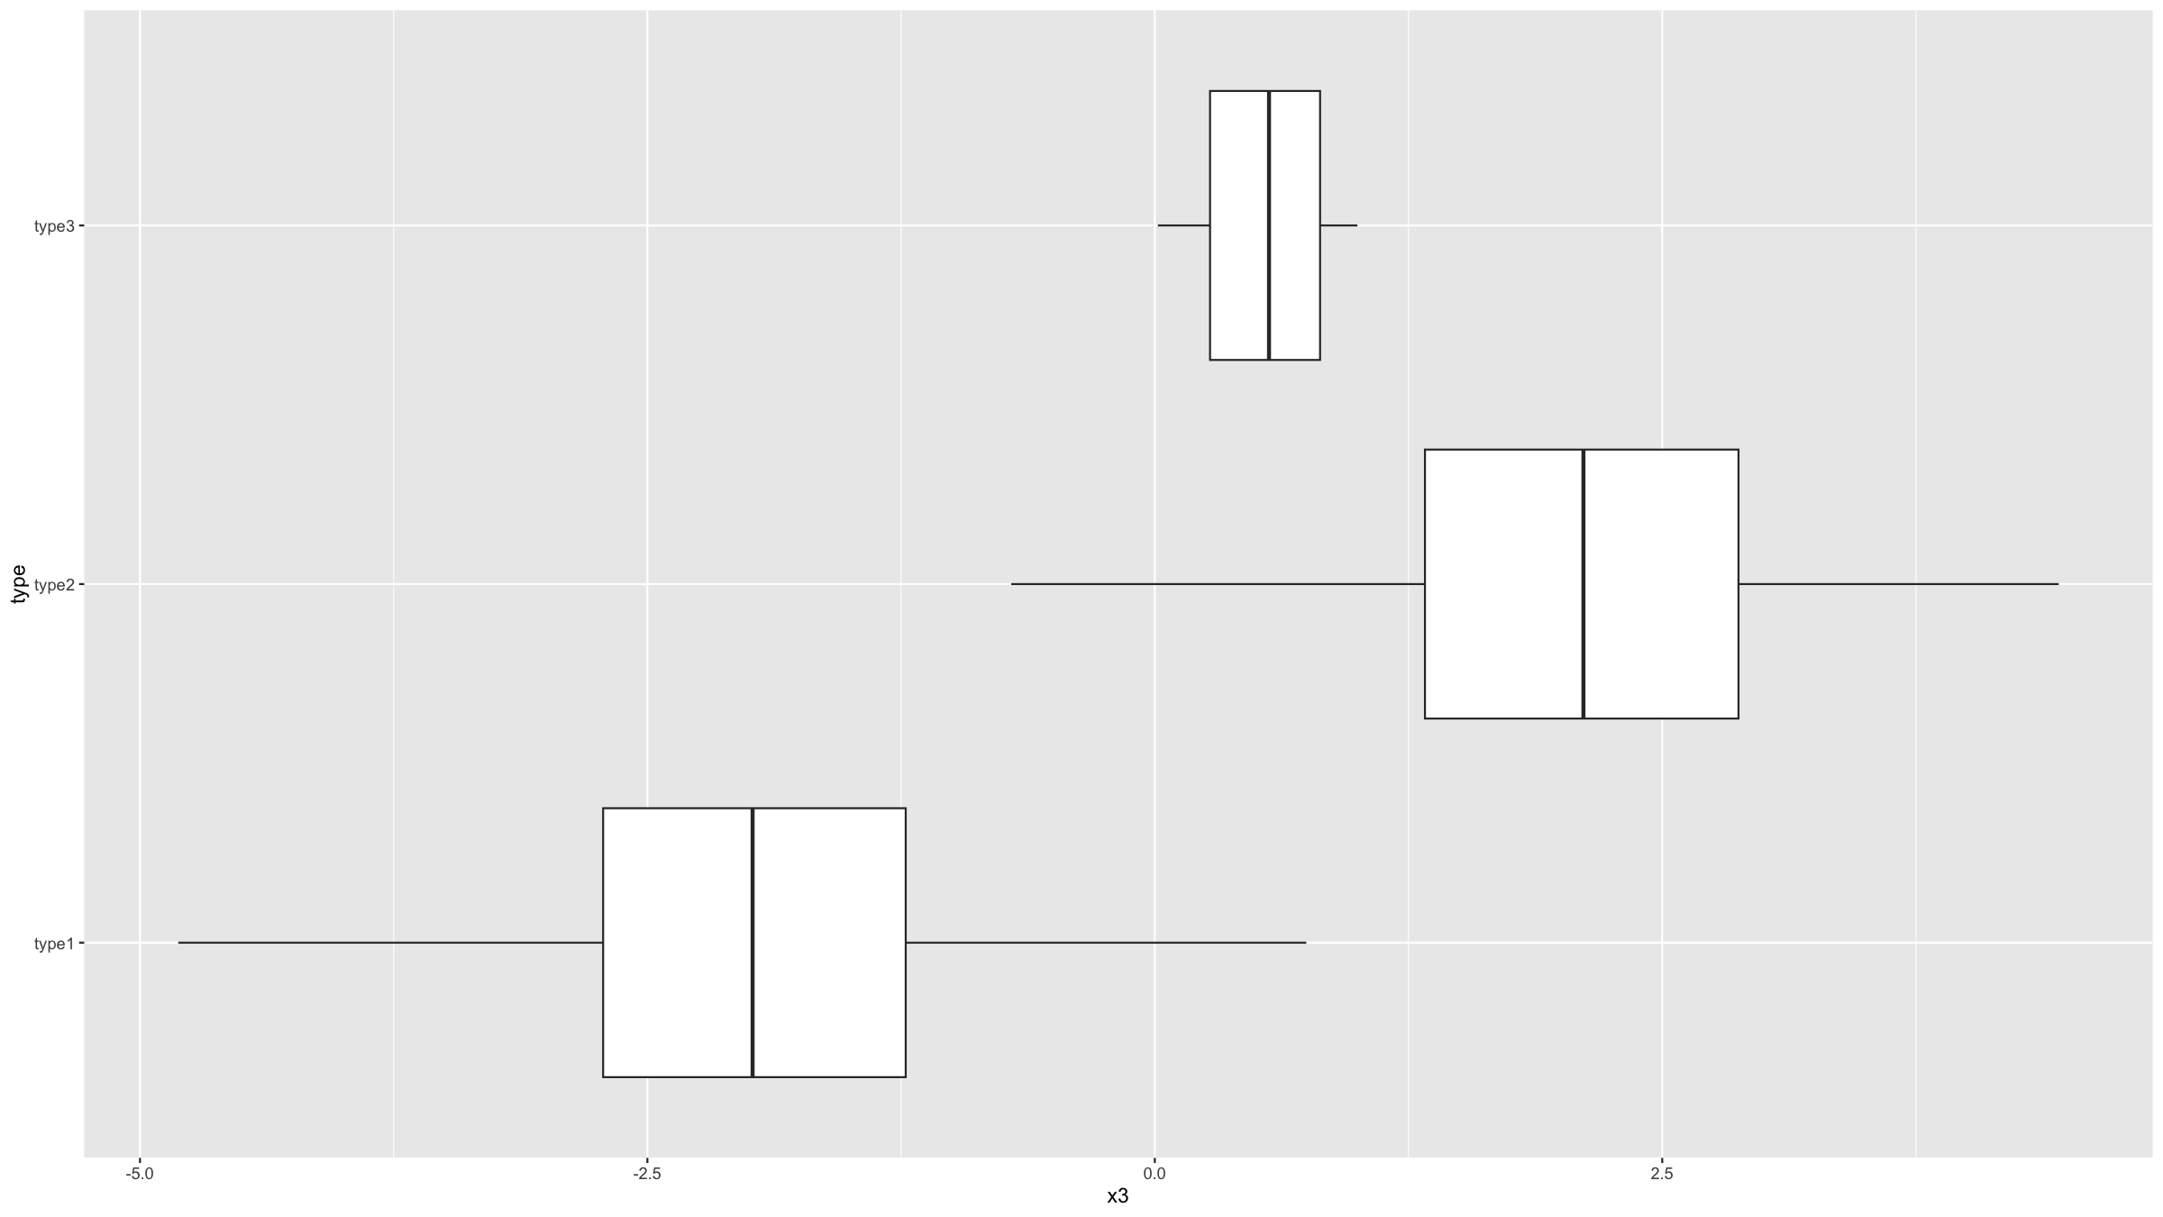
Covariation figures
You can also generate horizontal boxplots, by flipping the coordinate system.
ggplot(data=dat,mapping=aes(x=type,y=x3)) + geom_boxplot() + coord_flip()

Slide 133
Covariation figures
It is important that you understand what information is summarised in a boxplot.

Slide 134
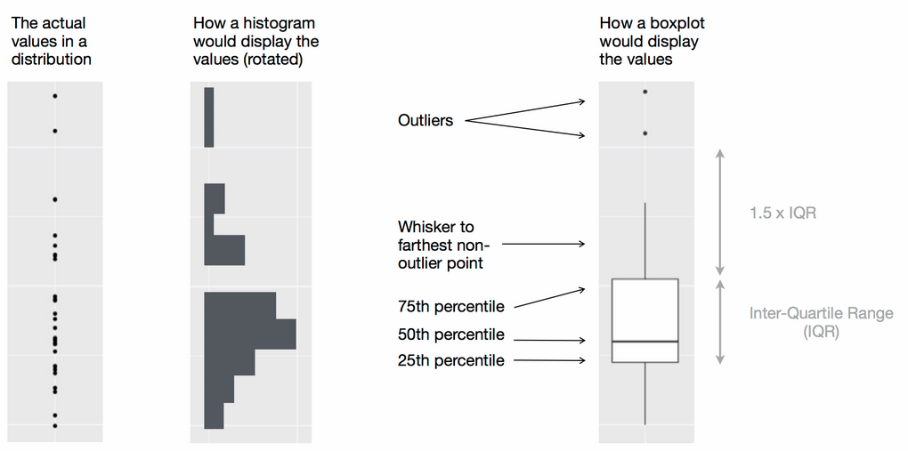
Covariation figures
Wickham, H. & Grolemund G., R for Data Science, O’Reilly, 2016

Slide 135
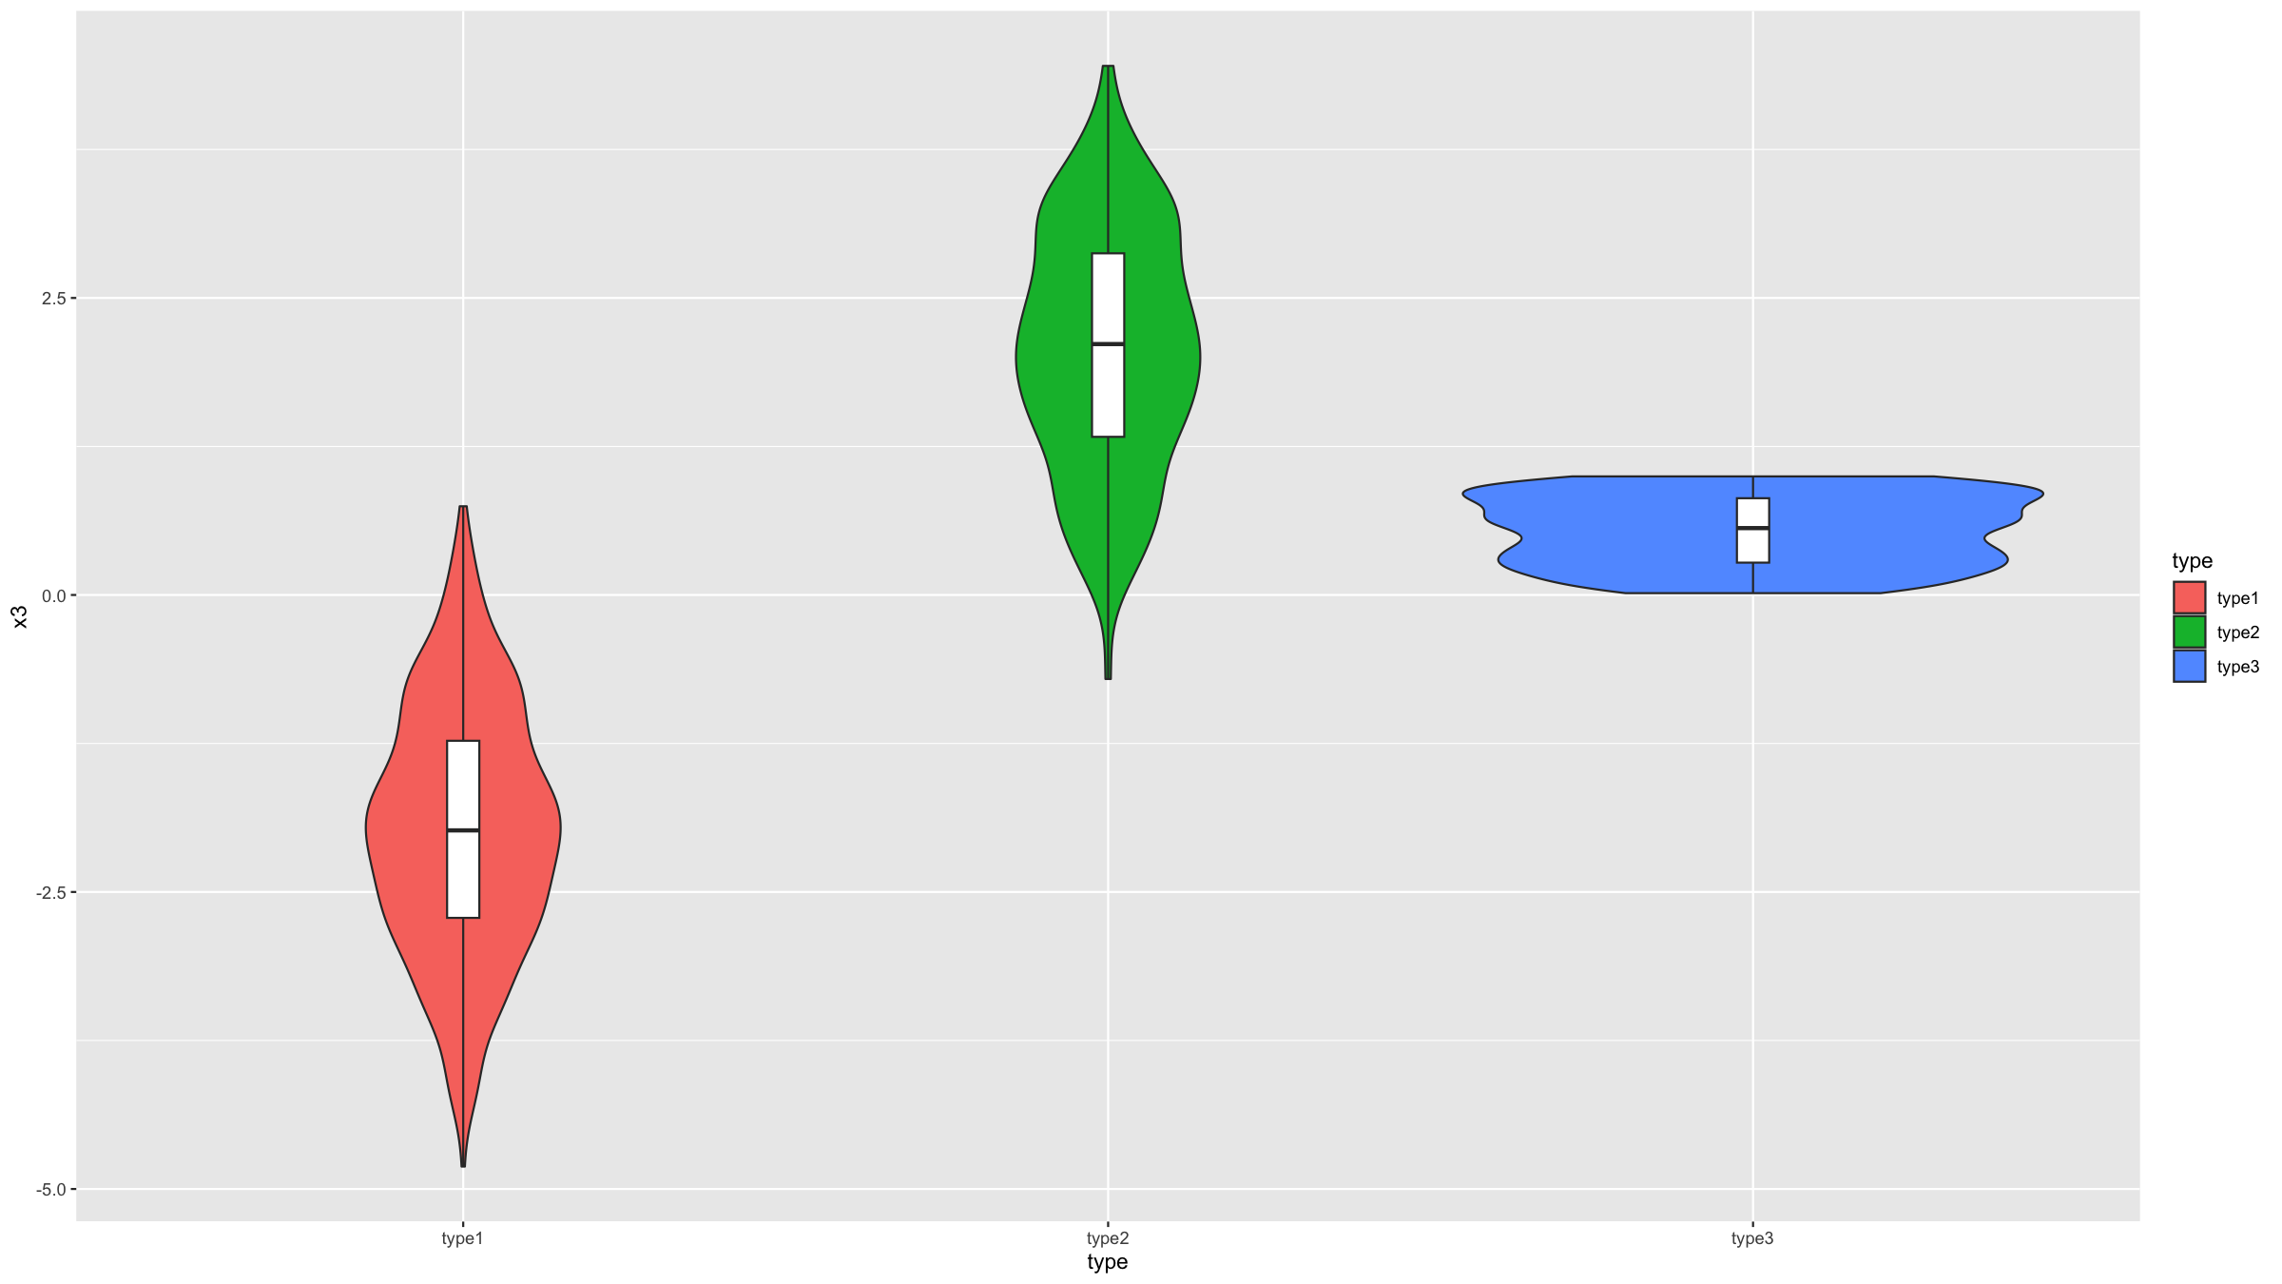
Covariation figures
Violin plots are similar to boxplots, but they combine box plots with histograms.
In ggplot2, the geom geom_violin() is used to generate these types of graphs.
ggplot(data=dat,mapping=aes(x=type,y=x3,fill=type)) + geom_violin() + geom_boxplot(width=0.05, fill="white")

Slide 136
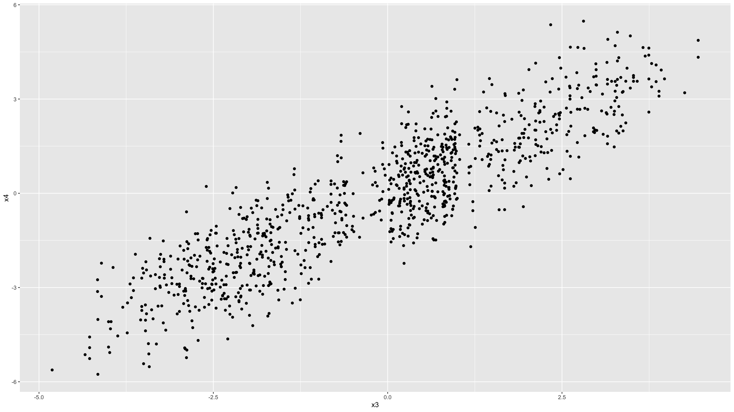
Covariation figures
The scatter plot, which shows 2 continuous variables plotted against each other, is probably the most basic and most used covariation plot.
For example, it is the basis of any graph showing a regression model.
The geom geom_point() is used to generate scatter plots in ggplot2.
ggplot(data=dat,mapping=aes(x=x3,y=x4)) + geom_point()

Slide 137
Covariation figures
This can be customised and you can easily add smooth regression lines with geom_smooth().
Note that the colour of the individual points is given by the col argument and so scale_colour_manual() is used to specify colours (rather than scale_fill_manual() as was used above in the example for histograms).

Slide 138
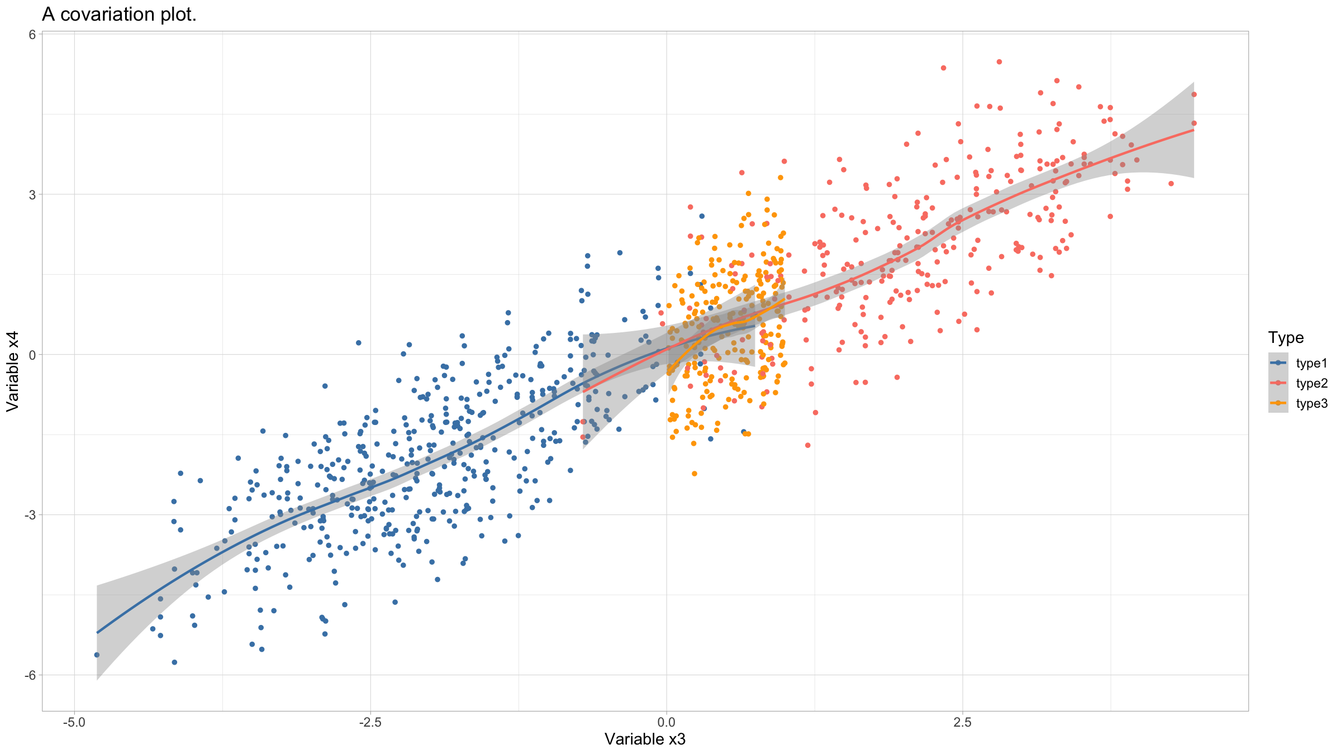
Covariation figures
ggplot(data=dat,mapping=aes(x=x3,y=x4,col=type)) + geom_point() + geom_smooth() + scale_colour_manual(values=c("steelblue","salmon","orange"), name="Type") + xlab("Variable x3") + ylab("Variable x4") + ggtitle("A covariation plot.") + theme_light() + theme(text=element_text(size=14)) ## `geom_smooth()` using method = 'loess' and formula = 'y ~ x'

Slide 139
Covariation figures
If one of the 2 variables has an order to it, such as e.g. a time variable, then line graphs may be better suited.
The geom geom_line() is used for this.
For an example, we will use a dataset that comes with R: beavers which consists of body temperature measurements from 2 beavers, stored in data frame beaver1 and beaver2.

Slide 140
Covariation figures
beaver<-rbind(beaver1[beaver1$day==346,],beaver2[beaver2$day==307,]) beaver<-data.frame( name=c(rep("beaver1",sum(beaver1$day==346)), rep("beaver2",sum(beaver2$day==307))),beaver)

Slide 141
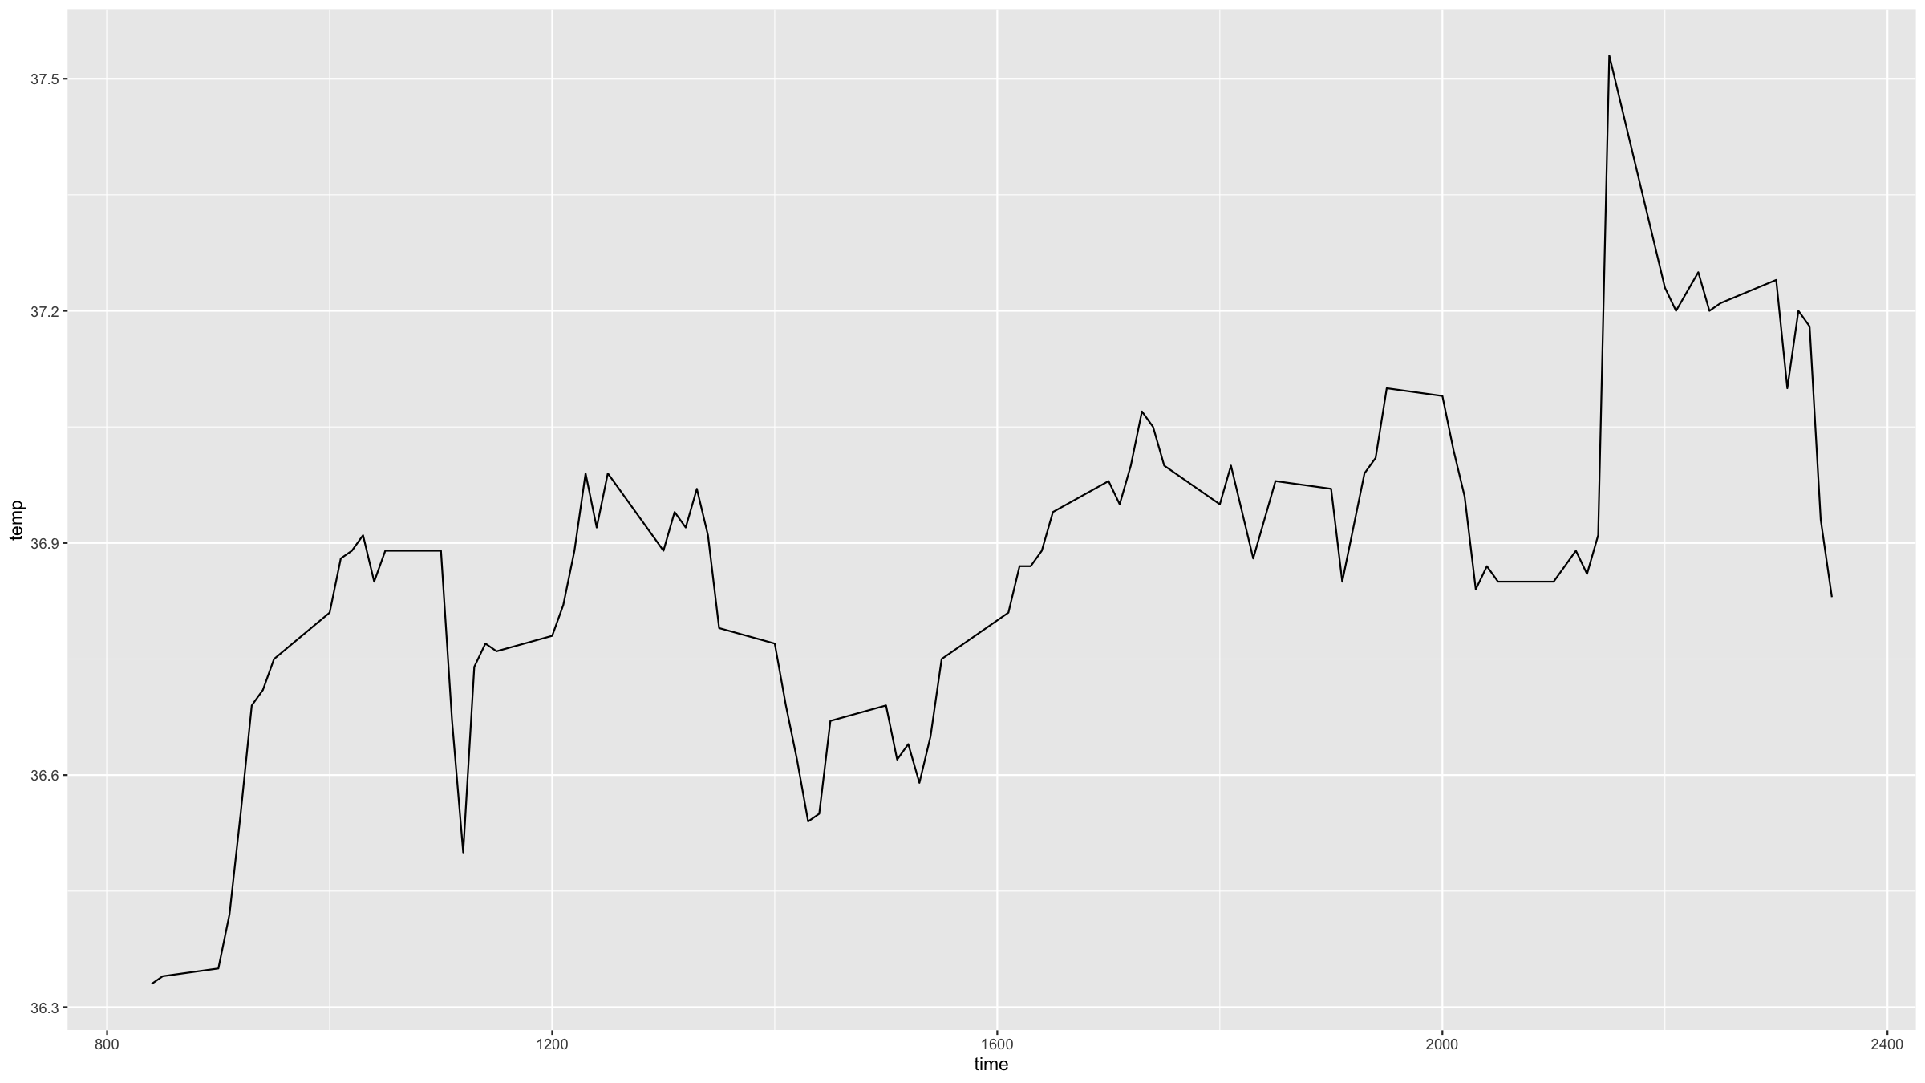
Covariation figures
For a simple line graph, you just need and x and a y variable.
beaver %>% filter(name=="beaver1") %>% ggplot(mapping=aes(x=time,y=temp)) + geom_line()

Slide 142
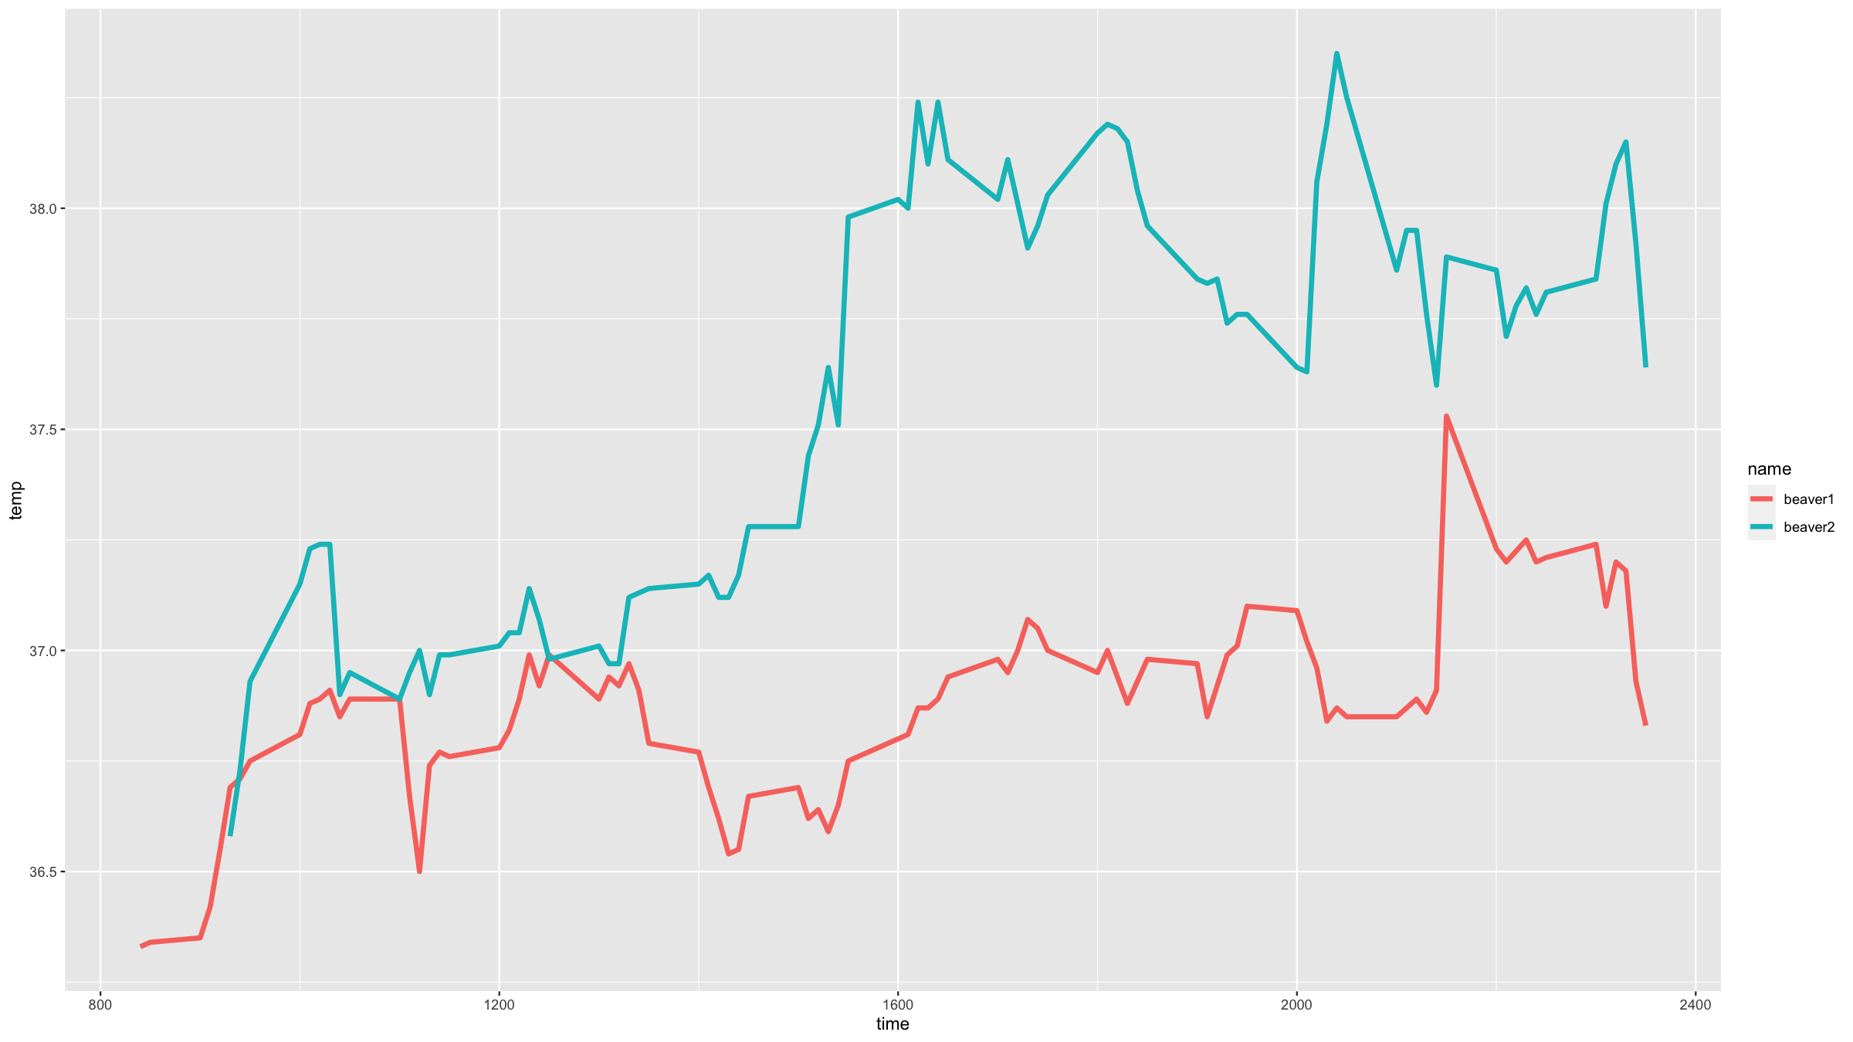
Covariation figures
You can easily stratify a line graph by a grouping variable (in this case the variable name) in ggplot2.
ggplot(data=beaver,mapping=aes(x=time,y=temp,colour=name)) + geom_line(lwd=1.5) # the lwd parameter sets the line width

Slide 143
Covariation figures
Heatmaps are useful to show covariation among 3 variables.
The x- and y-axis show 2 of the variables and the third variable determines the colour of cells.
The variables can be either categorical or continuous.
In ggplot2, one geom that you can use for heatmaps is geom_tile().
First, we need some data.

Slide 144
Covariation figures
dens<-function(x,y){ return( 0.35*dnorm(x)*dnorm(y,sd=1.5) + 0.65*dnorm(x,mean=2,sd=2)*dnorm(y,mean=3) ) } x<-seq(-2.5,6.5,by=0.05) y<-seq(-3,5.5,by=0.05) densSurf<-expand.grid(x=x,y=y) %>% mutate(dens=dens(x,y))

Slide 145
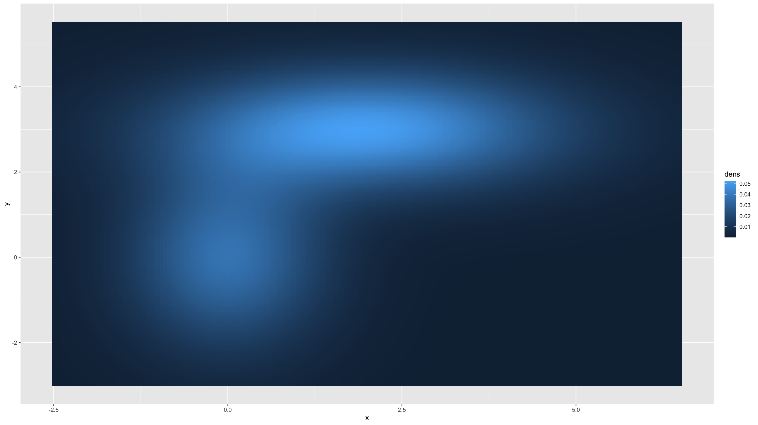
Covariation figures
Then we can do a basic heat map, using default colours.
densSurf %>% ggplot(mapping=aes(x=x,y=y,fill=dens)) + geom_tile(width=0.05,height=0.05)

Slide 146
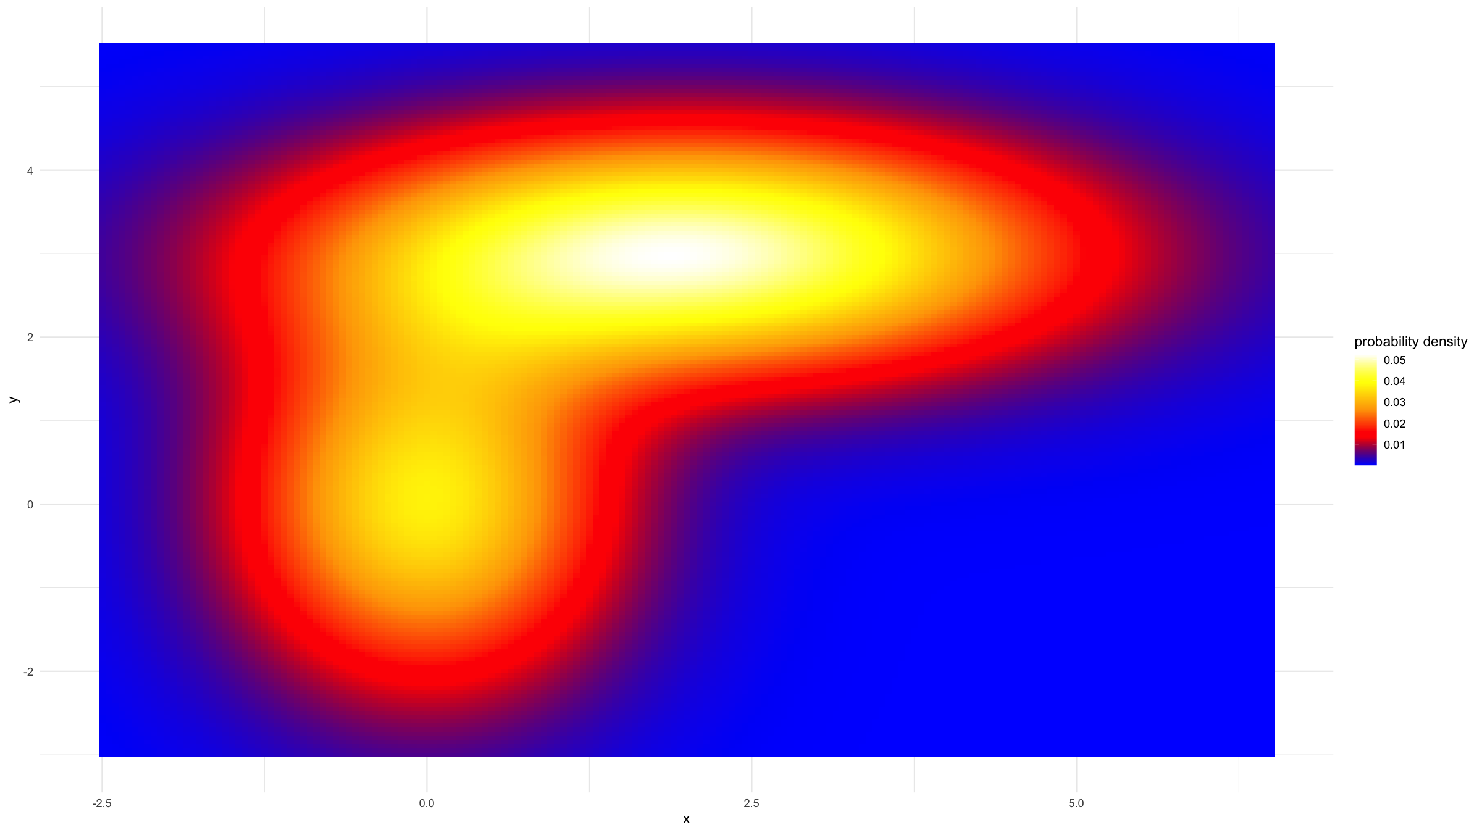
Covariation figures
But we can also provide custom colour scales.
clrs<-colorRampPalette(c("blue","red","orange","yellow","white")) densSurf %>% ggplot(mapping=aes(x=x,y=y,fill=dens)) + geom_tile(width=0.05,height=0.05) + scale_fill_gradientn(colours = clrs(200),name="probability density") + theme_minimal()

Slide 147
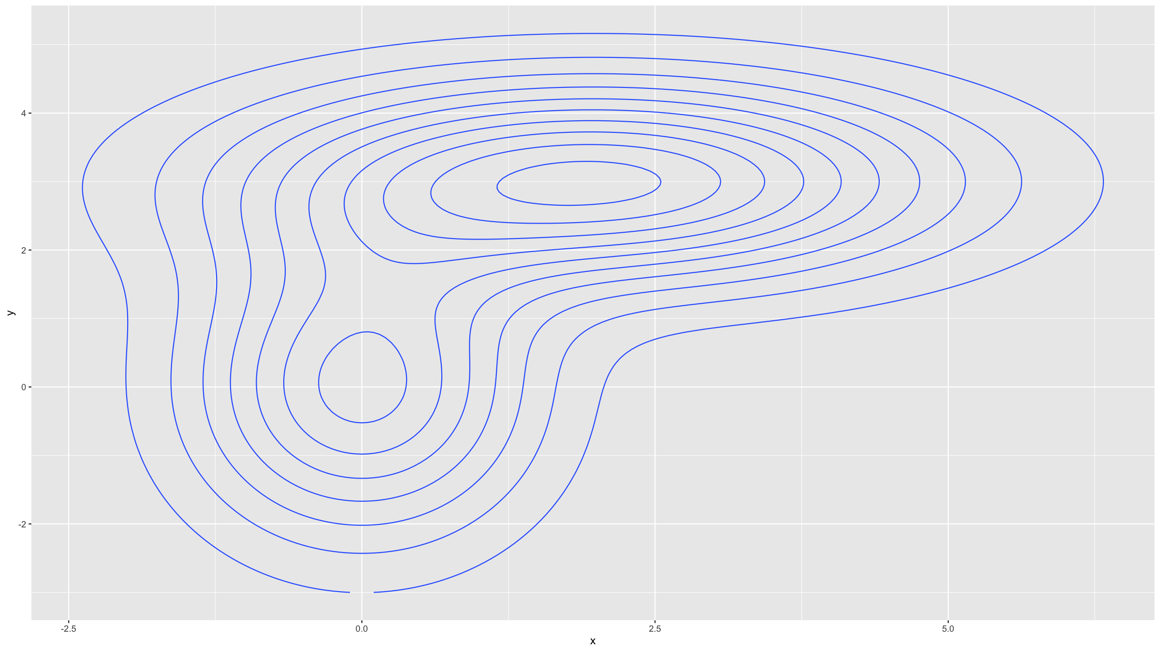
Covariation figures
Contour plots are similar but use contour lines rather than colour scales to show variation in the third variable.
ggplot(data=densSurf,mapping=aes(x=x,y=y,z=dens)) + geom_contour()

Slide 148
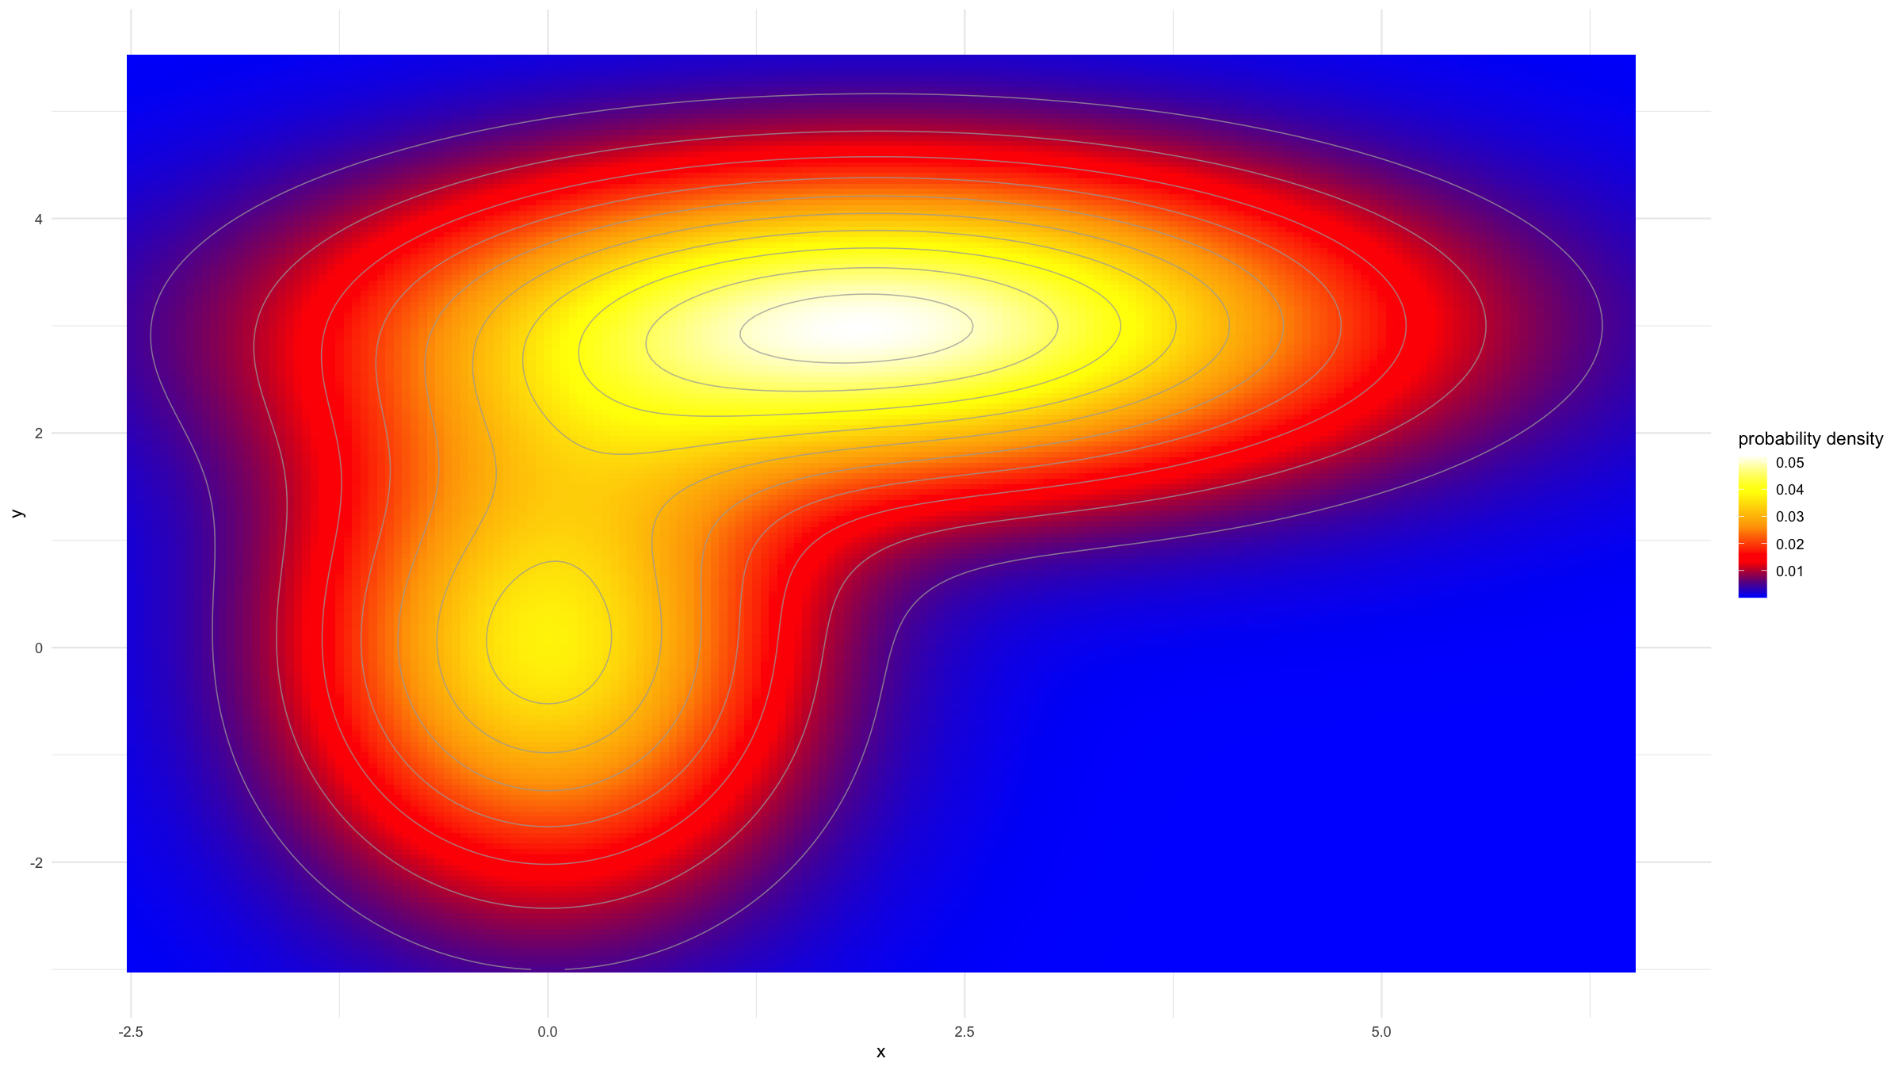
Covariation figures
You can combine heampaps and contour plots.
densSurf %>% ggplot(mapping=aes(x=x,y=y,fill=dens,z=dens)) + geom_tile(width=0.05,height=0.05) + geom_contour(col="darkgrey",lwd=0.35,alpha=0.75) + scale_fill_gradientn(colours = clrs(200),name="probability density") + theme_minimal() ## Warning: The following aesthetics were dropped during statistical transformation: fill ## ℹ This can happen when ggplot fails to infer the correct grouping structure in ## the data. ## ℹ Did you forget to specify a `group` aesthetic or to convert a numerical ## variable into a factor?

Slide 149
Multi-panel figures

Slide 150
Multi-panel figures
There’s multiple ways to generate multi-panel figures. Here we just cover 2 examples.
For a basic, but general way of combining multipe graphs onto the same figure, the function grid.arrange() from the R package gridExtra can be used.
The procedure is very simple:
Load the package (if not loaded already): library(gridExtra)
Assign each ggplot() call to an object (e.g. p1<-ggplot(...) + ...)
Produce a multipanel figure with grid.arrange(p1,p2,...,nrow=2)
The nrow parameter specifies over how many rows you want to arrange the plots.

Slide 151
Multi-panel figures
g1<-ggplot(data=dat,mapping=aes(x=type,y=x3)) + geom_boxplot() + geom_jitter(width=0.25,height=0,alpha=0.3) + xlab("") + ylab("Variable x3") + ggtitle("A box & jitter plot.") + theme_minimal()

Slide 152
Multi-panel figures
g2<-ggplot(data=dat,mapping=aes(x=x3,y=x4,col=type)) + geom_point() + geom_smooth() + scale_colour_manual(values=c("steelblue","salmon","orange"), name="Type") + xlab("Variable x3") + ylab("Variable x4") + ggtitle("A covariation plot.") + theme_light() + theme(text=element_text(size=14))

Slide 153
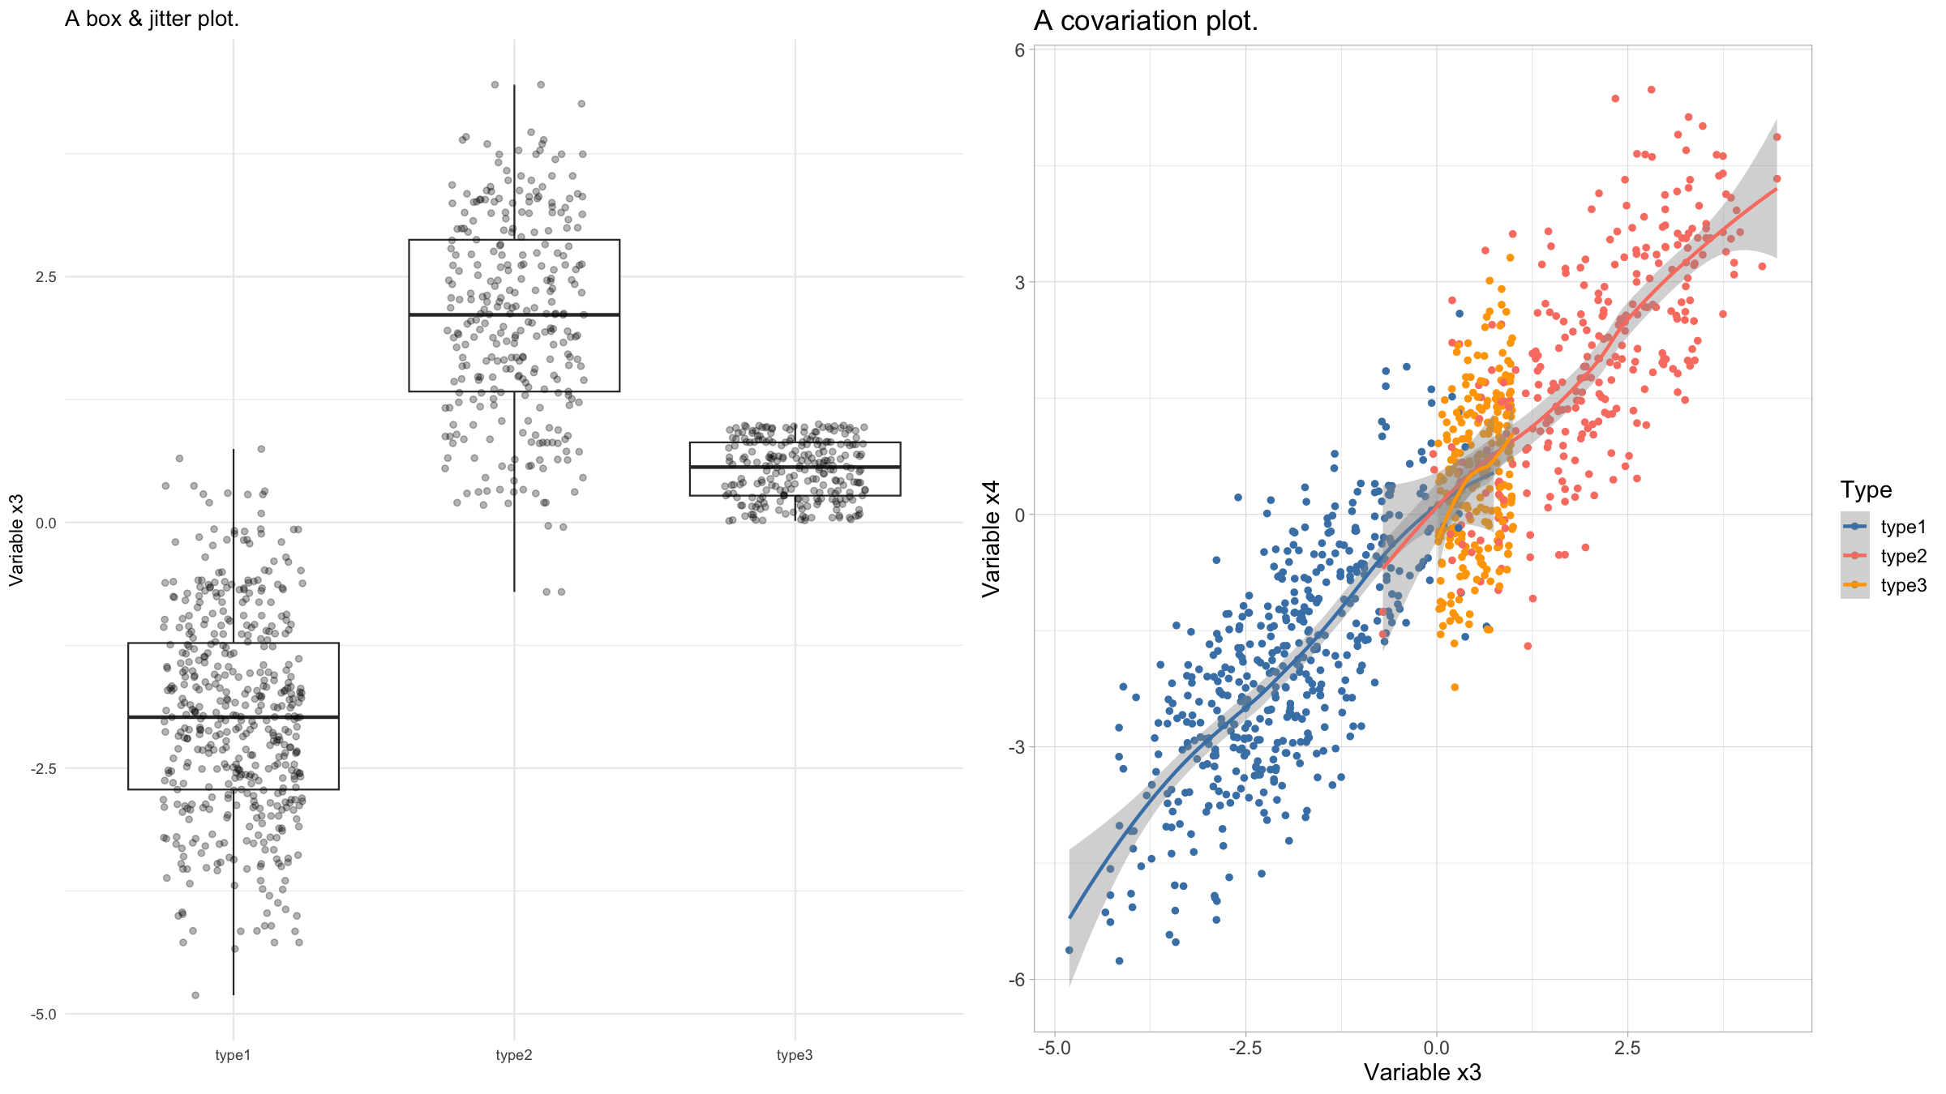
Multi-panel figures
grid.arrange(g1,g2,nrow=1) ## `geom_smooth()` using method = 'loess' and formula = 'y ~ x'

Slide 154
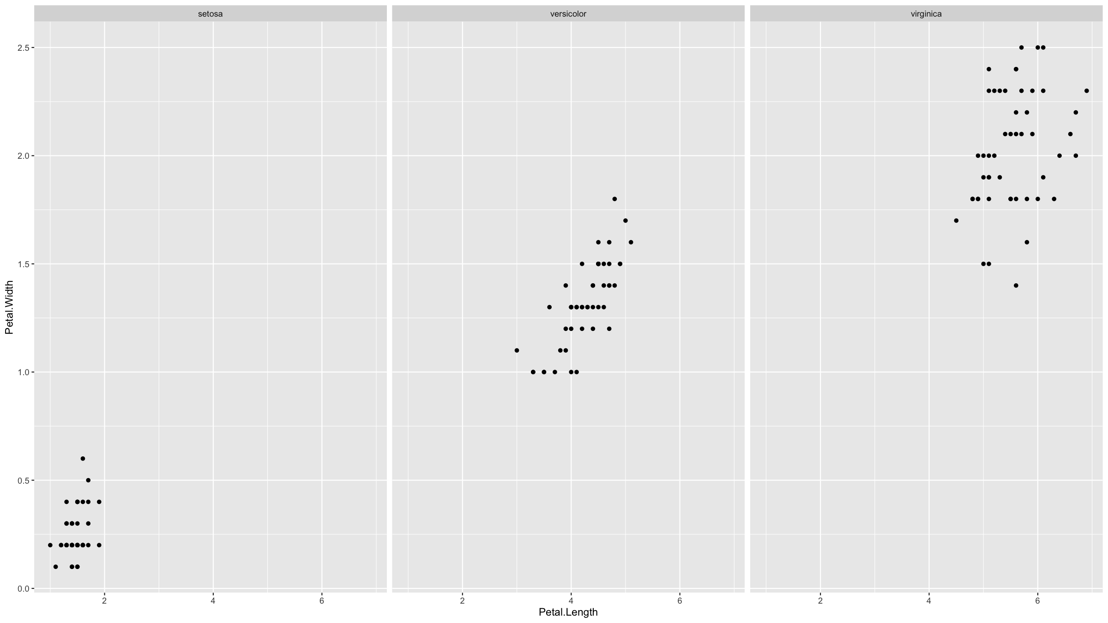
Multi-panel figures
The other approach we will cover, is if you want to repeat the same graph for different groups of observations within your dataset.
This is called faceting and in ggplot2 the function facet_wrap() allows to do this very easily.
iris %>% ggplot(mapping=aes(x=Petal.Length,y=Petal.Width)) + geom_point() + facet_wrap(~Species)

Slide 155
Saving graphs to files

Slide 156
Saving figures
In ggplot2, the simplest way to save graphs is to use the function ggsave().
ggsave(g1,filename="myplot.png",width=16,height=9,units="cm",dpi=450)

Slide 157
Saving figures
Another way is to enclose your plotting code inside a statement that specifies a graphics device. “Graphics device” means a pdf, png, jpg or other file.
Example:
pdf(width=16,height=9,file="myfile.pdf") # opens the device; pdf will produce vector graphics # plotting code here dev.off() # closes the device

Slide 158
Saving figures
Or:
png(width=16,height=9,units="in",res=450) # raster graphics # plotting code here dev.off()

Slide 159
[end of Session 1]

